Slide 1
The 2014 Flash Flood and Intense Rainfall Experiment
Faye E. Barthold^{1,2}, Thomas E. Workoff^{1,3}, Wallace A. Hogsett^{1*}, J.J. Gourley⁴, and David R. Novak¹
With special thanks to Brian Cosgrove, NOAA/NWS/Office of Hydrologic Development
¹NOAA/NWS/Weather Prediction Center, College Park, MD
²I.M. Systems Group, Inc., Rockville, MD
³Systems Research Group, Inc., Colorado Springs, CO
⁴NOAA/National Severe Storms Laboratory, Norman, OK
*Current Affiliation: Weather Analytics, Bethesda, MD

Slide 2
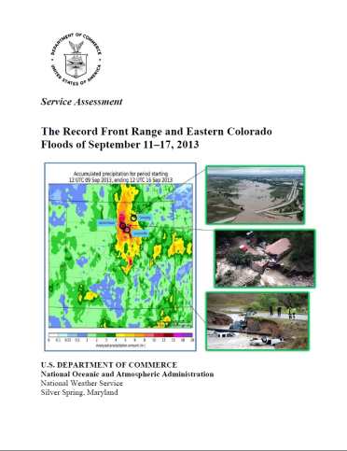
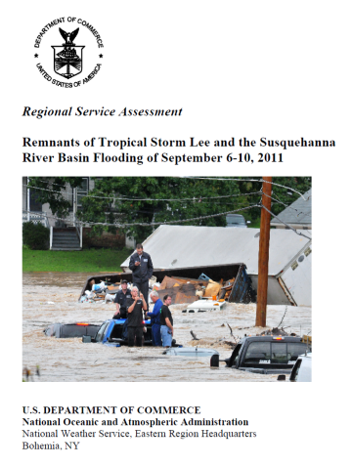
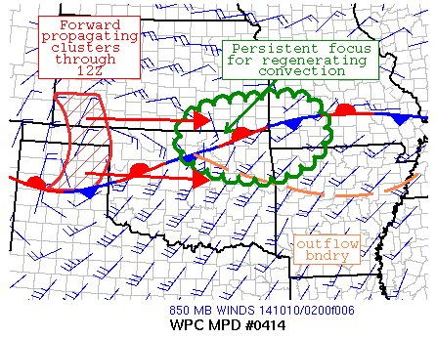
Motivation
On average, flooding results in ~$8 billion
in damages and ~90 fatalities per year
7 of the last 10 NWS Service Assessments
have involved flooding
WPC Excessive Rainfall Outlooks
Day 1-3 forecasts
Highlight probability that rainfall will
exceed flash flood guidance at a point
WPC Mesoscale Precipitation
Discussions
Event-driven forecasts
Highlight regions where heavy rainfall
may lead to flash flooding in the next 1-6 hours

Slide 3
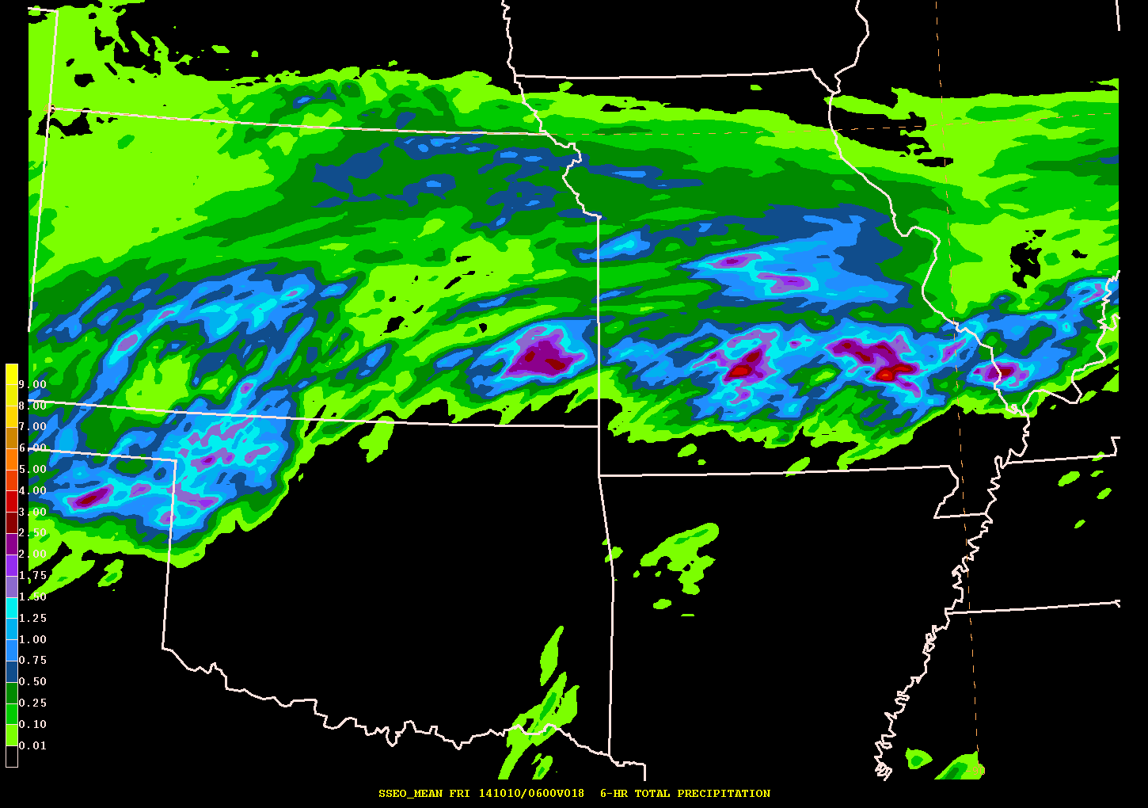
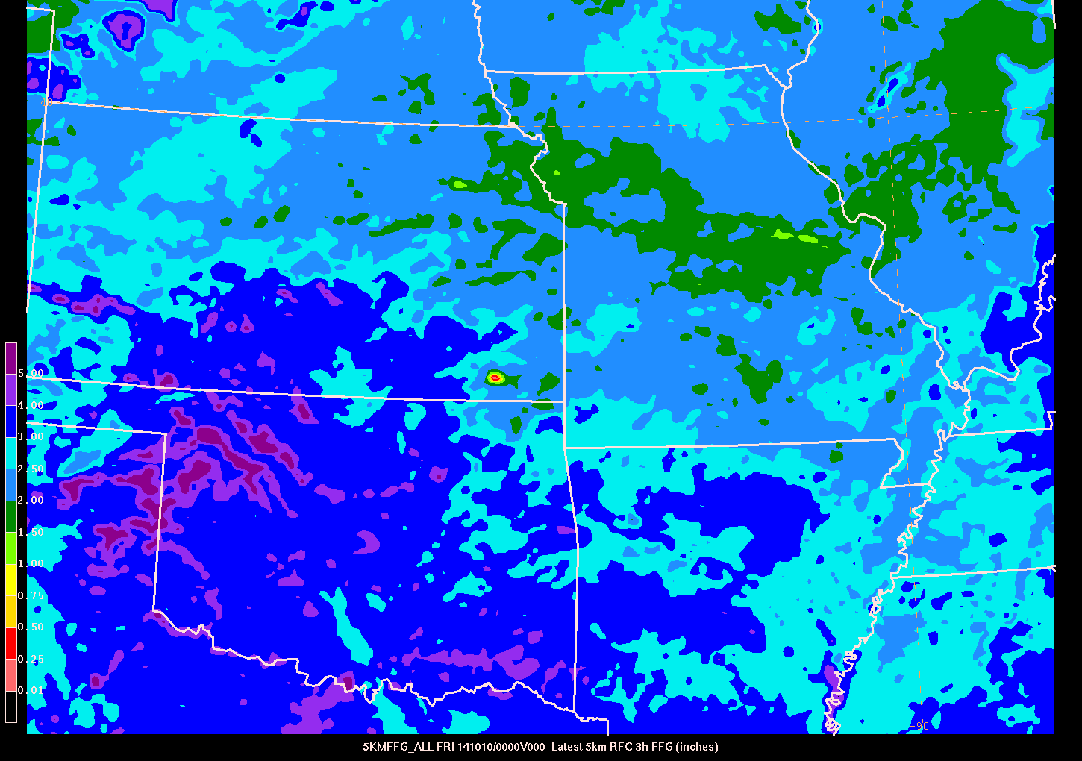
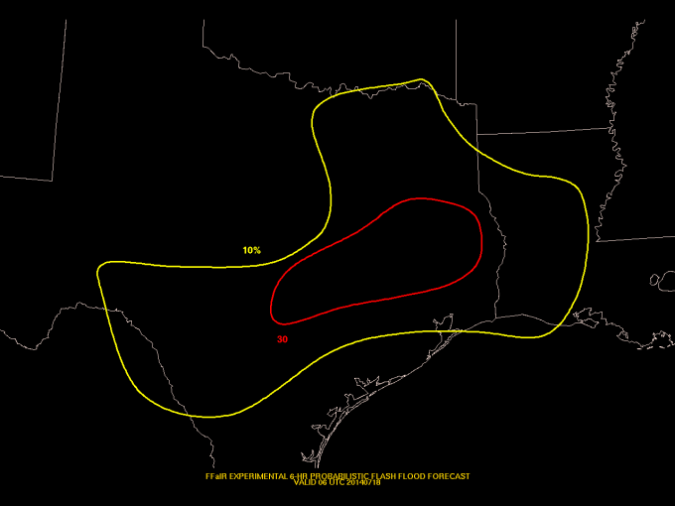
Lessons Learned from 2013 FFaIR
High resolution convection-
allowing guidance can
provide valuable information
about the flash flood threat,
particularly when paired with
hydrologic information
Forecast verification extremely
difficult – no single
comprehensive source of
information about observed
flash flooding
?

Slide 4
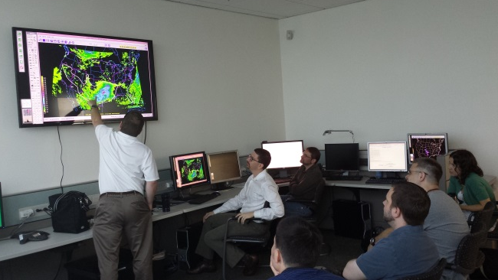
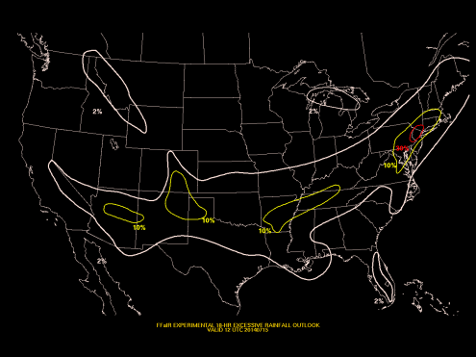
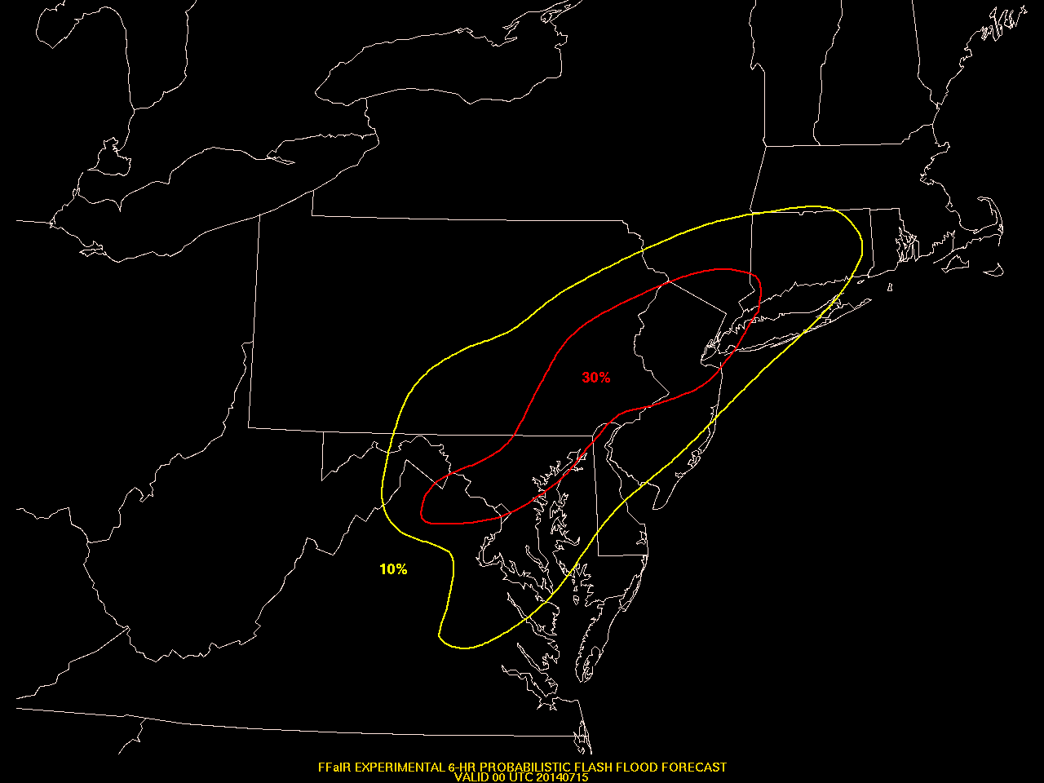
Flash Flood and Intense Rainfall Experiment July 7-25, 2014
Explore the utility of convection-allowing models in the flash flood forecast process
23 participants representing operations,
research, and academia
Daily Activities
18 hr CONUS probabilistic flash flood
outlook (18-12 UTC)
Prototype of next generation ERO
6 hr event-driven probabilistic flash flood
forecasts (18-00 UTC and 00-06 UTC)
Forecast discussion
Used to brief concurrent HWT-Hydro
experiment
Subjective evaluation

Slide 5
Featured Model Guidance
Provider | Model | Resolution | Forecast Hours
EMC | Parallel NAM* | 12km (parent) 4km (nest) | 84 (parent) 60 (nest)
ESRL/GSD | HRRR | 3 km | 15
SPC | SSEO (7 members) | 4 km | 36
WPC | Modified SSEO (7 members) | 4 km | 24
EMC | NCASE-TL (15 members) | 4 km | 12
ESRL/GSD | ExREF (8 members) | 9 km | 84
HRRR
Modified SSEO
ExREF
Parallel NAM
SSEO
NCASE-TL
*The parallel NAM used during the experiment became operational on 12 August 2014

Slide 6
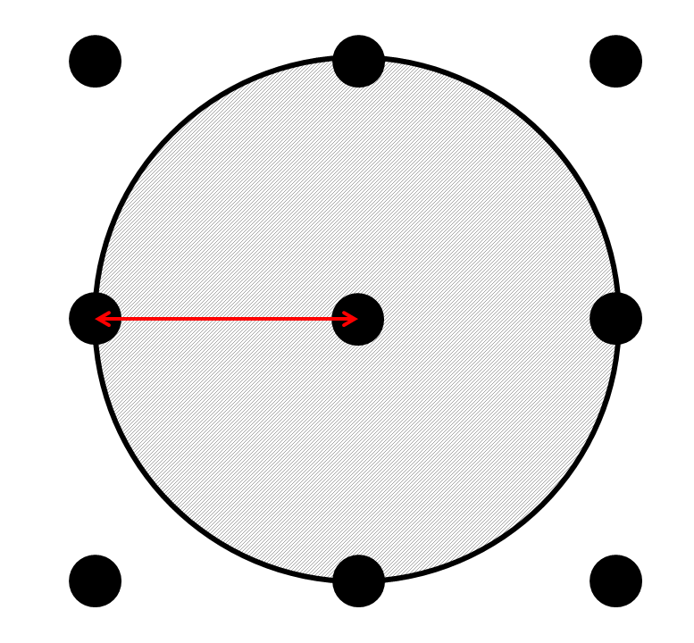
Ensemble Forecast Tools Neighborhood Probabilities
Probability of an event occurring within a certain distance of a grid point
40 km radius
Accounts for spatial uncertainty in the forecast
Max member QPF
Is QPF > 2”?
✓
✓
1.4”
2.4”
.78”
✓
✓
✗
✗
✓
2.3”
✓
✓
✓
1.8”
2.7”
✗
✓
✓
2.8”
✓
✓
✓
3.7”
4.3”
✓
✓

Slide 7
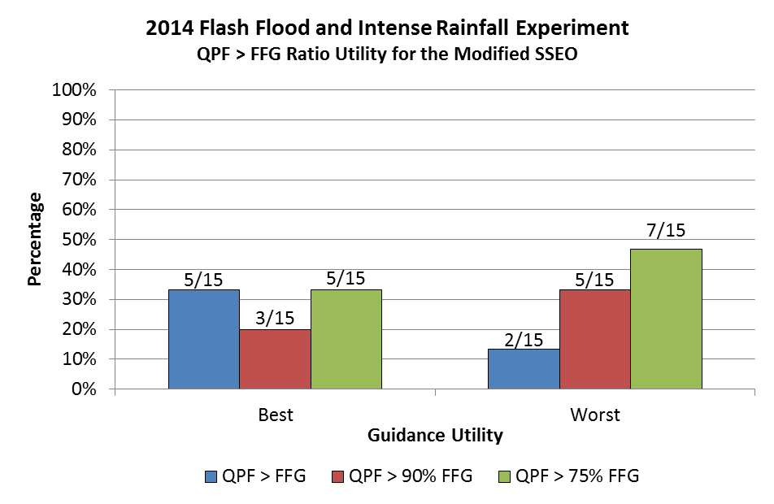
Ensemble Forecast Tools Neighborhood Probabilities
Events
Probability of QPF exceeding a threshold (e.g. 3”)
Probability of QPF exceeding FFG
Probability of QPF exceeding % FFG
QPF > FFG
QPF > 90% FFG
QPF > 75% FFG

Slide 8
Flash Flood Verification Database
WPC flash flood verification database
NWS Local Storm Reports
Flash flood
Flood
NSSL mPING reports of flooding
USGS stream gauge exceedance
information
Postgres database updated
throughout the day to capture
latest observations
Can request data for user-defined
time periods
Yellow – flash flood LSR
Blue – flood LSR
Brown – mPING
Pink - USGS

Slide 9
“Practically Perfect” Analysis Technique
Converts point observations
into contoured probabilistic
forecast areas using a Gaussian
weighted function
Work in progress
Consider including additional data
Heavy rain LSRs
Flash flood warnings
QPE
Consider weighting datasets
differently based on quality of data
source and relevance to flash flooding

Slide 10
Experiment Findings
The NWS needs to have a more consistent approach to the flash flood problem from definition, to warning practices, to reporting
Inconsistencies from WFO to WFO result in a moving target when trying to identify where flash flooding has occurred
Convection-allowing ensembles are invaluable to the flash flood forecast process, especially when paired with hydrologic data in the form of neighborhood probabilities
Helps account for spatial uncertainty in both QPF and the hydrologic response

Slide 11
Experiment Findings
Flash flood forecasting in the western U.S. represents a more significant challenge
Need both improved model guidance and improved forecaster understanding of the unique drivers of flash flooding in the west
Updating WPC’s Excessive Rainfall Outlook to use a neighborhood probabilistic approach will provide more inclusive forecast guidance highlighting the threat for flash flooding

Slide 12
Future Work
Explore alternative hydrologic information for neighborhood probabilities
Precipitation recurrence intervals
Make neighborhood probabilities of QPF > FFG available via FTP
Continue to explore improved flash flood forecast verification
Refine practically perfect technique
Make verification database publically accessible
Full experiment report available at:
http://www.hpc.ncep.noaa.gov/hmt/FFaIR_2014_final_report.pdf

