Slide 1
Recent Advancements from the Research-to-Operations (R2O) Process at HMT-WPC
Thomas E. Workoff^{1,2}, Faye E. Barthold^{1,3}, Michael J. Bodner¹, David R. Novak¹, Brad Ferrier^{3,4}, and Wallace A. Hogsett^{1*}
¹NOAA/NWS/Weather Prediction Center, College Park, MD
²Systems Research Group, Inc., Colorado Springs, CO
³I.M. Systems Group, Inc., Rockville, MD
⁴NCEP/Environmental Modeling Center, Camp Springs, MD
*Current affiliation: Weather Analytics, Inc., Bethesda, MD

Slide 2
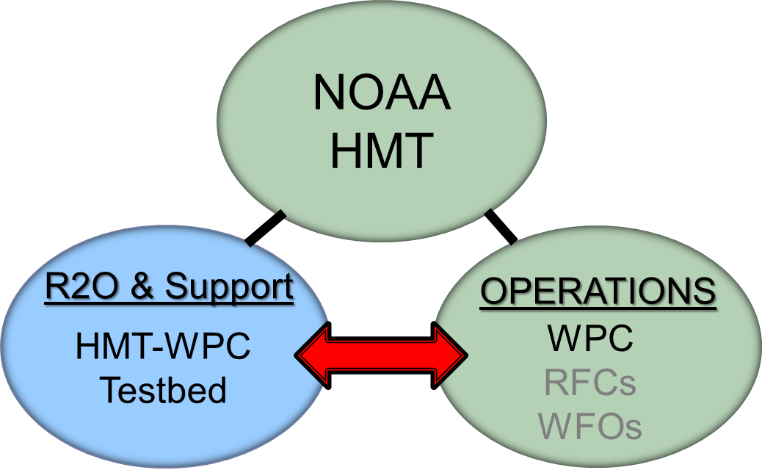
HMT-WPC: What do we do?
WPC Mission Statement: A leader in the collaborative weather forecast process delivering responsive, accurate, and reliable national forecasts and analyses.
Accelerate the transfer of scientific and technological innovations into operations to enhance WPC products and services.

Slide 3
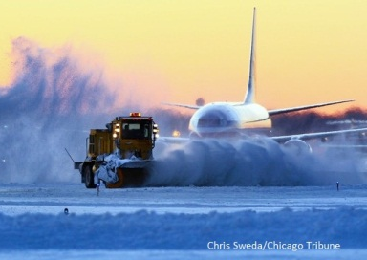
How do we do it?
The R2O Process
Identify the problem(s)
“How do we improve our forecasts?”
“Can we make additional or supplemental forecast products to better serve our customers’ changing needs?”
Identify the Problem
Develop Solutions
Test & Evaluate
Implement & Train

Slide 4
R2O at WPC: How it Really Works
Three-step transition process:
Identify/develop and test new datasets, models and techniques
NAM Rime Factor Snowfall, Day 4-7 Winter Weather Guidance
Test in forecast experiments
Winter Weather Experiment
Atmospheric River Retrospective Forecasting Experiment (ARRFEX)
Flash Flood and Intense Rainfall Experiment
Subjective and objective evaluation: does it provide value in the forecast process?
Does it help the forecaster make a better forecast?
Operational training and implementation
Establish dependable data format, data feed, train forecasters on most effective uses, etc.

Slide 5
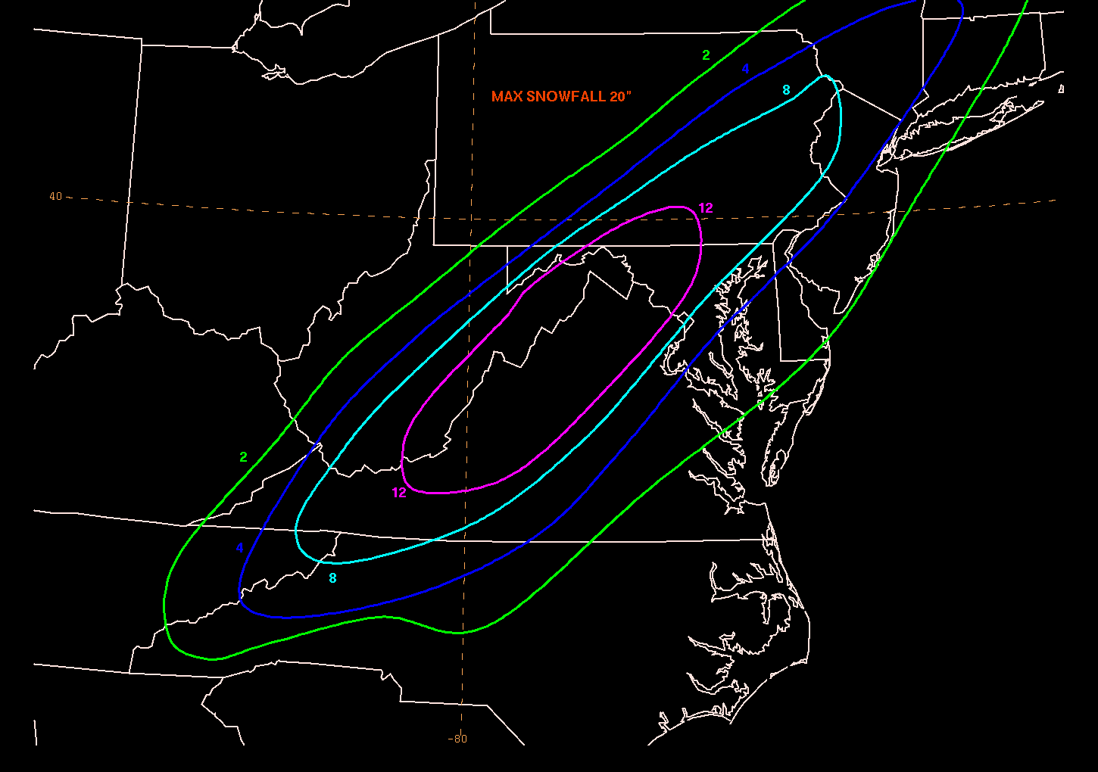
HMT-WPC Winter Weather Experiment
Explore new techniques to improve WPC’s snowfall forecasts, including new approaches to quantifying and communicating forecast uncertainty
4 years – 73 total participants representing
operations, research, and academia
Daily Activities
Experimental snowfall forecasts (probabilistic
and deterministic)
Short-term (Day 1/Day 2)
Medium range (Day 4-7)
Subjective & objective evaluations
Decision support graphics & briefings

Slide 6
Goal: Improve Snowfall Forecasts: NAM Rime Factor-Modified Snowfall
Model snowfall forecasts are often, um, uninspiring….
Instantaneous process:
QPF x ptype x SLR = snowfall
Modifies Roebber* SLR (courtesy of Brad Ferrier, EMC)
Rime Factor (instantaneous) – indicates amount of growth of ice particles by riming and liquid water accretion
Percent Frozen QPF (instantaneous) – percent of precipitation reaching the ground that is frozen
1 < RF < ~2 no change to Roebber SLR
~2 < RF < ~5 Roebber SLR reduced by factor of 2
~5 < RF < ~20 Roebber SLR reduced by factor of 4
RF > ~20 Roebber SLR reduced by factor of 6
*Roebber, P. J., S. L. Bruening, D. M. Schultz, and J. V. Cortinas, 2003: Improving snowfall forecasting by
diagnosing snow density. Wea. Forecasting, 18, 264-28

Slide 7
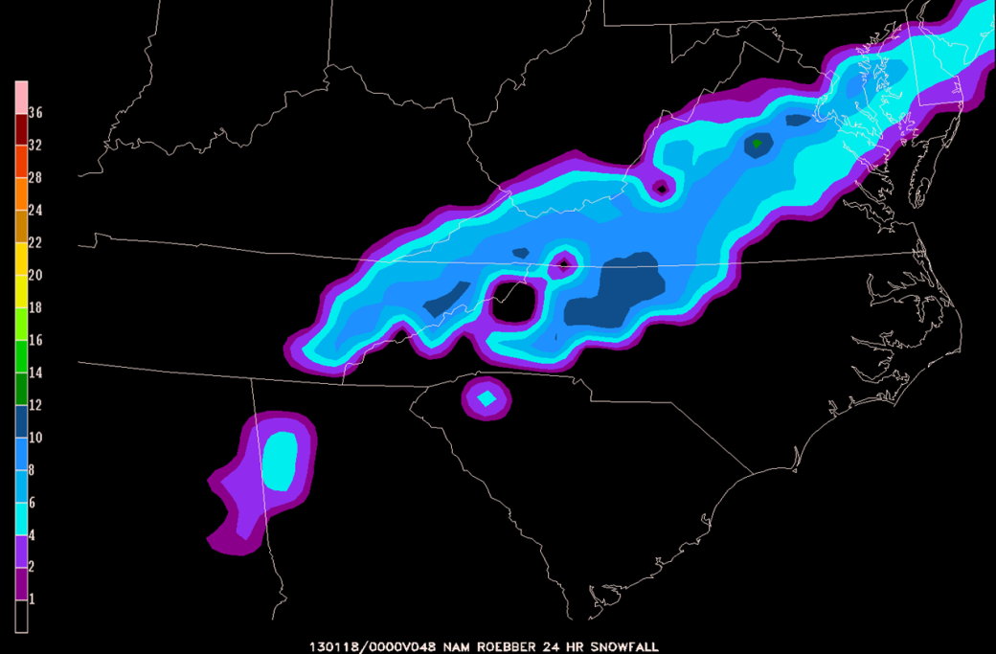
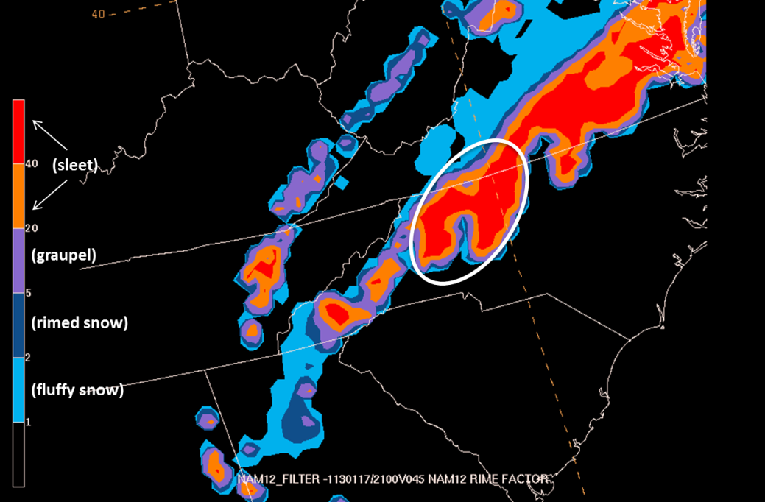
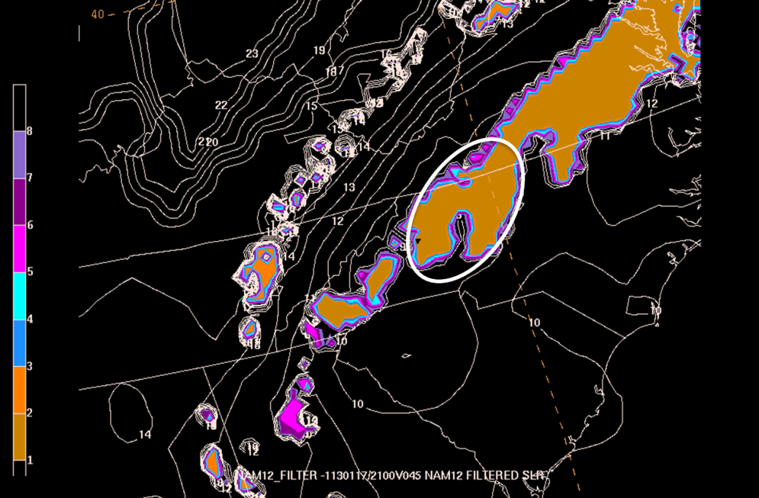
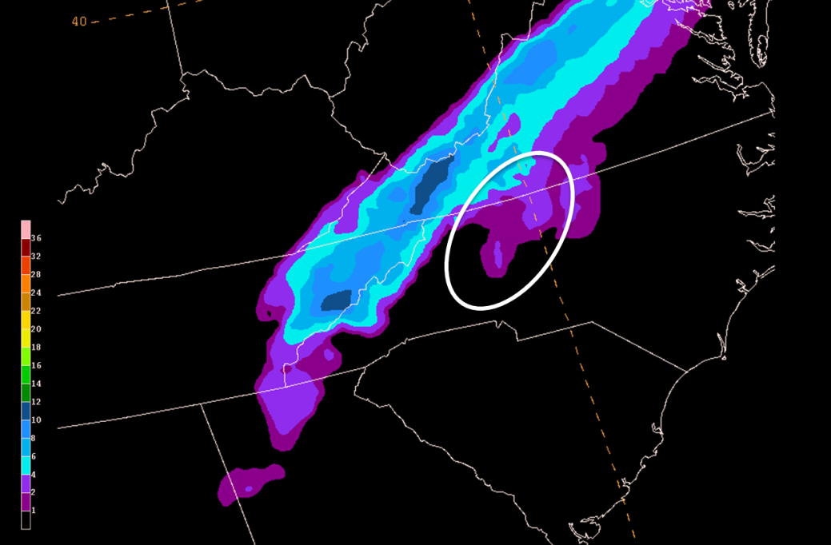
Example: January 17-18, 2013
NAM Roebber Snowfall
NAM Rime Factor
NAM Rime Factor SLR
NAM RF-modified Snowfall

Slide 8
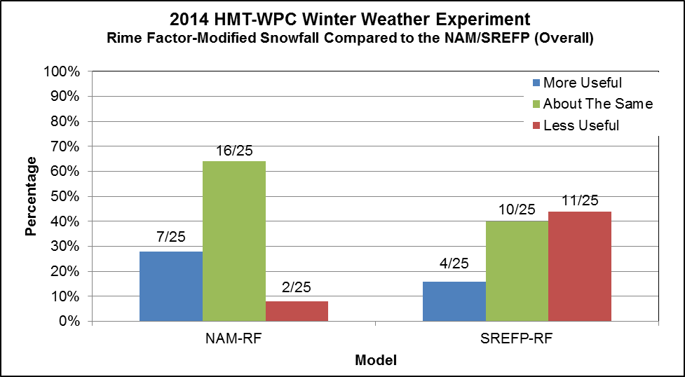
Goal: Improve Snowfall Forecasts: NAM Rime Factor-Modified Snowfall
2013 and 2014 Winter Weather Experiment:
24 hr snowfall forecasts (00 – 00 UTC): probabilistic and deterministic
Day 1 or Day 2
Rime Factor:
NAM (2013, 2014)
SREF-P (2014)
NAM-P Land Surface Coupling (2014)
Results
Helpful in p-type transition zones
RF, Percent of Frozen Precip (POFP) may be more helpful to forecasters than final snowfall product
What is the best way to apply to ensembles?

Slide 9
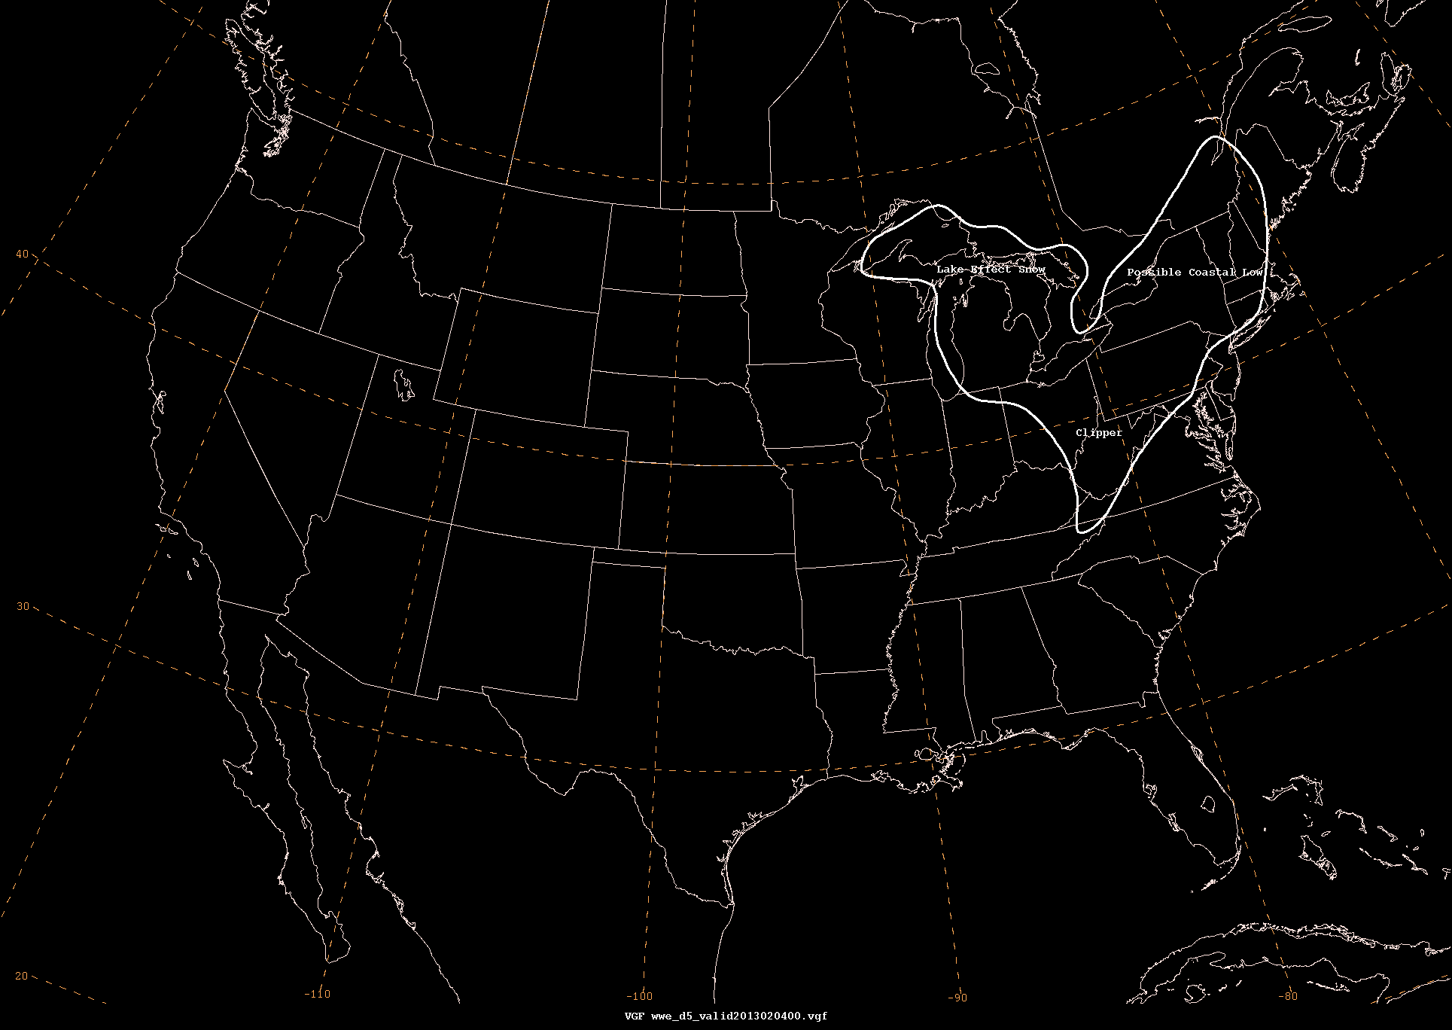
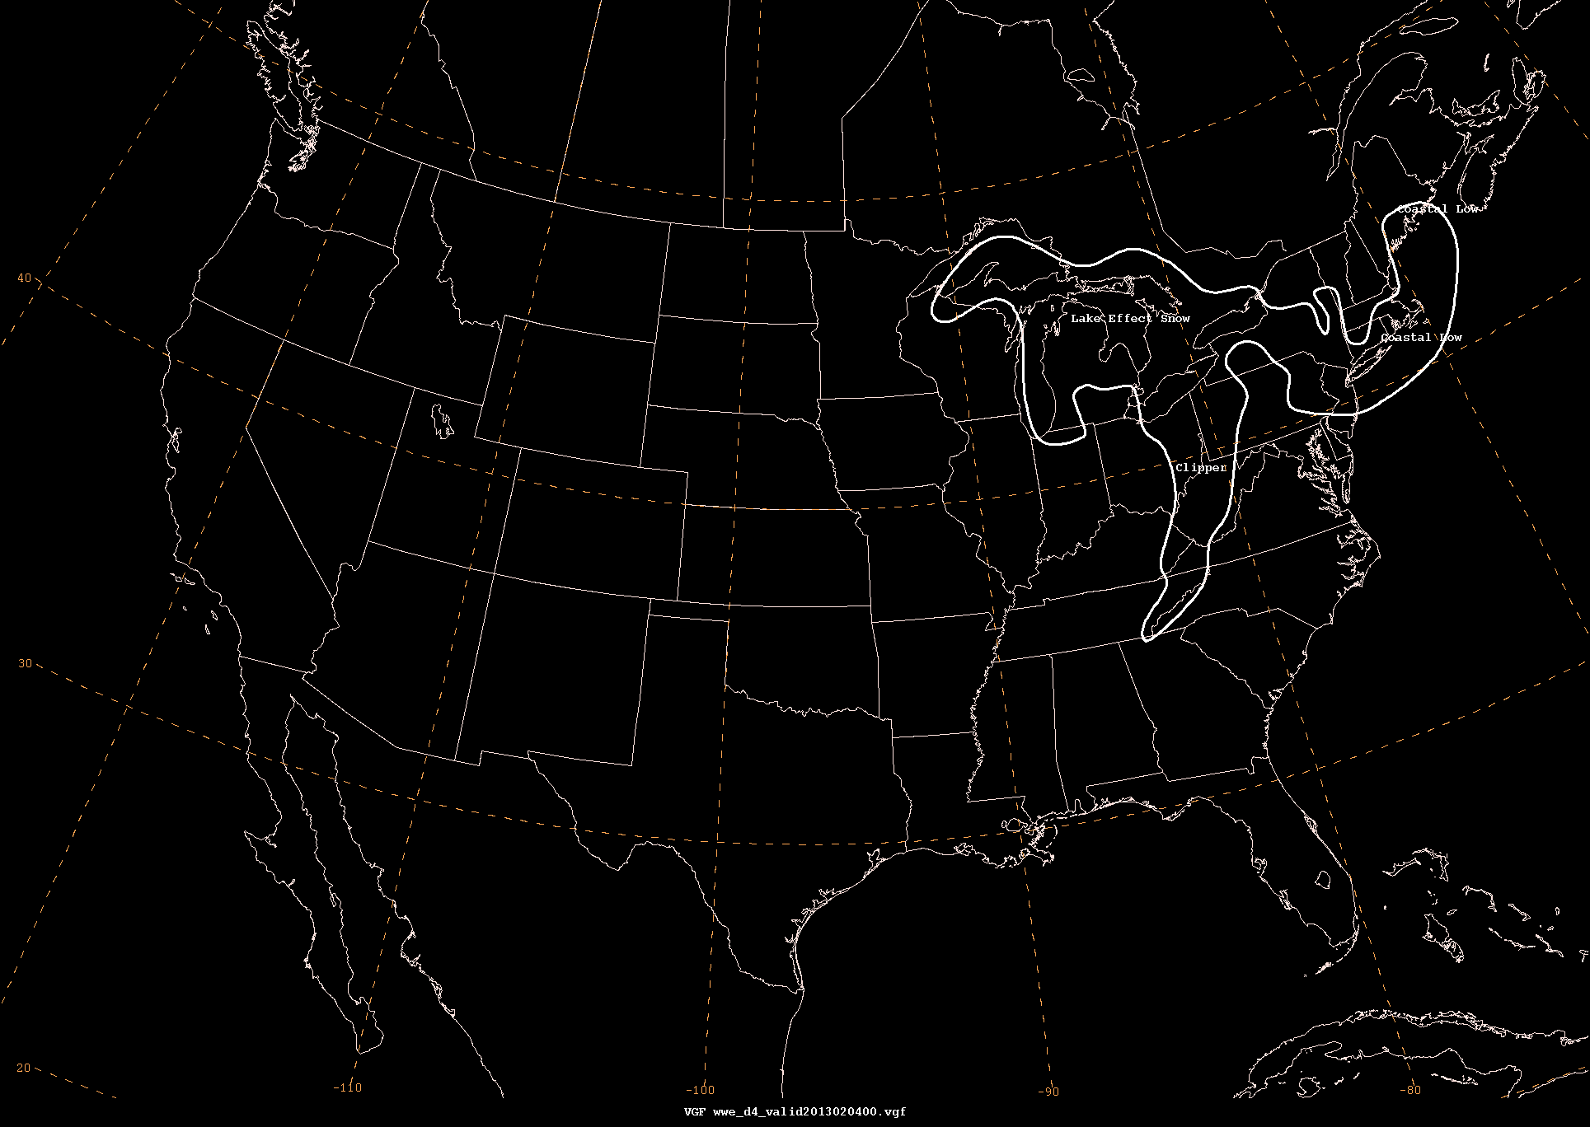
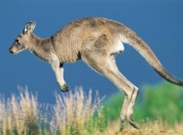
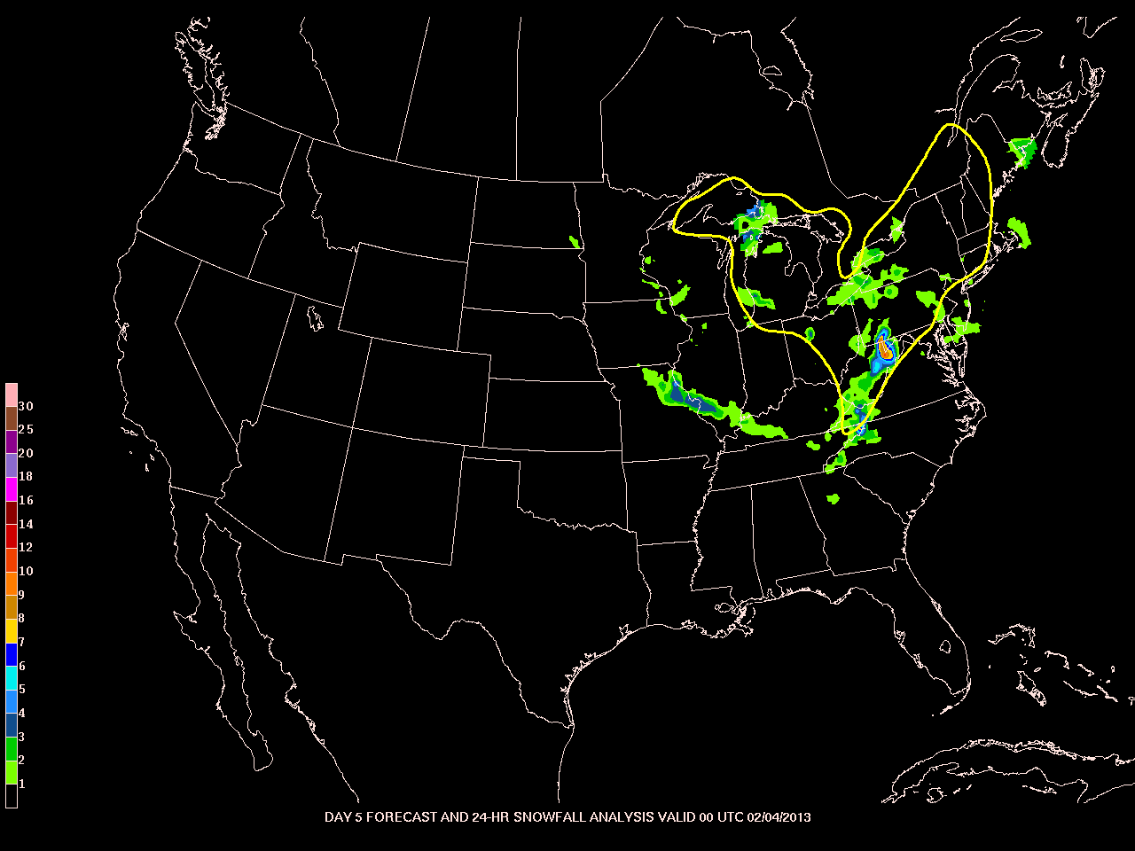
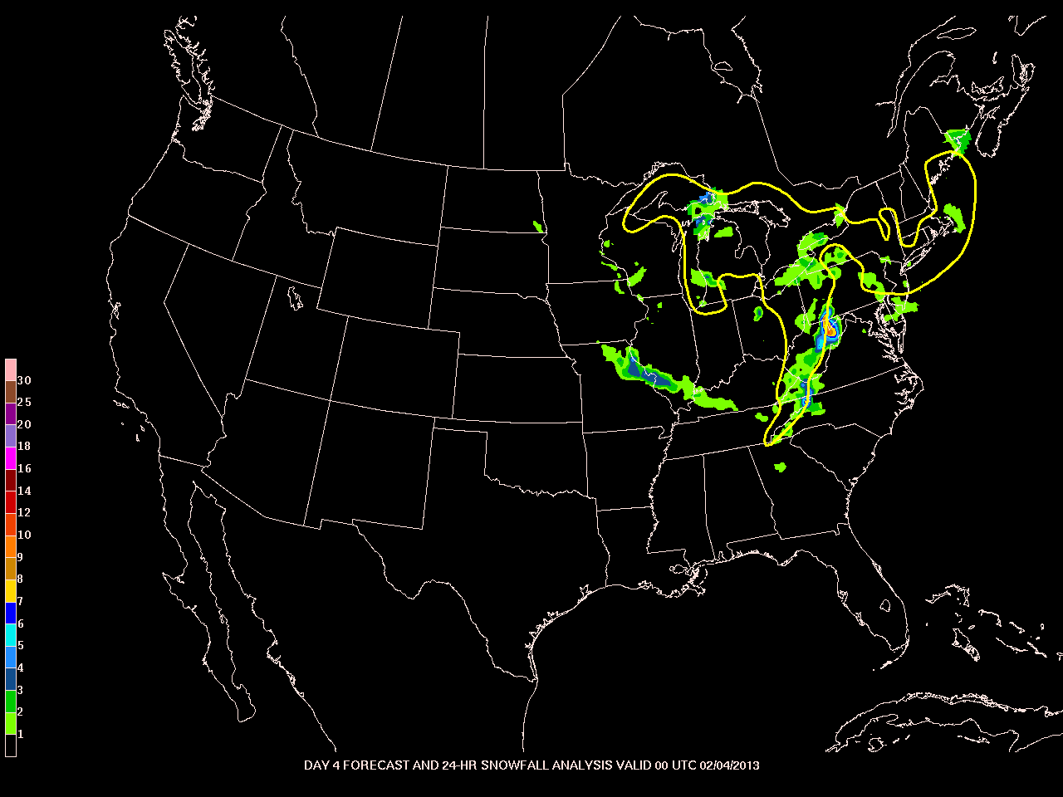
Goal: Extend Winter Weather Guidance into Days 4-7
2013 Winter Weather Experiment: Can we accurately predict winter weather at days 4 & 5?

Slide 10
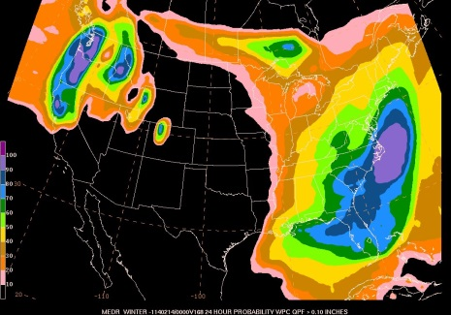
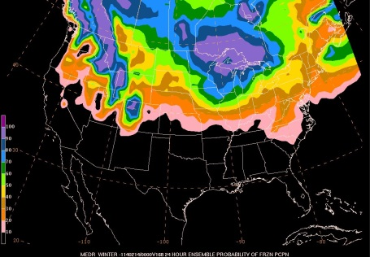
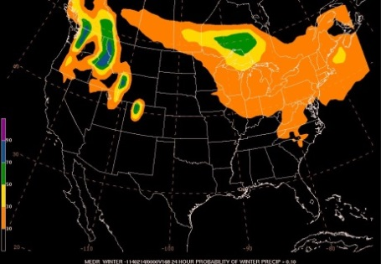
Goal: Extend Winter Weather Guidance into Days 4-7 (2014)
Day 4-7 Probability of >.1” of frozen precipitation
24 hour forecasts: day 4, 5, 6 and 7
Develop Guidance:
Disaggregate WPC Day 4-5, Day 6-7 QPF
Use GEFS and ECENS to generate CDF to extract probabilities of >.1” QPF
Combine with ensemble probability of frozen precipitation from GEFS and ECENS
Courtesy of Mike Bodner, WPC
Prob of WPC QPC >= 0.10”
Ensemble Prob of Fzn Precip
Prob of Winter Precip > 0.10”

Slide 11
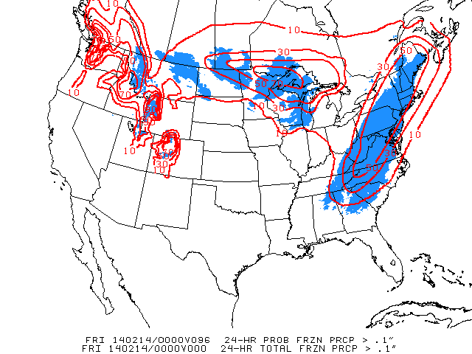
Goal: Extend Winter Weather Guidance into Days 4-7 (2014)
Day 4-7 Probability of >.1” of frozen precipitation
24 hour forecasts: day 4, 5, 6 and 7
Develop Guidance
Develop Verification
Stage IV & RTMA data to highlight areas of >.1” and <=0ºC
Tested and evaluated in the 2014
Winter Weather Experiment
Forecasters issue Day 4-7
PWQPF > .1”
Subjective & objective evaluation of
experimental forecasts and model
guidance

Slide 12
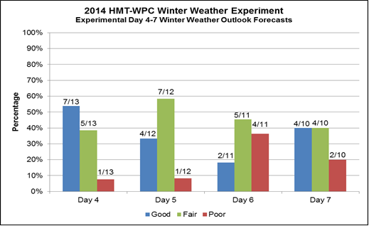
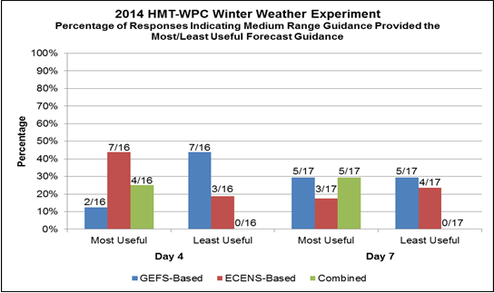
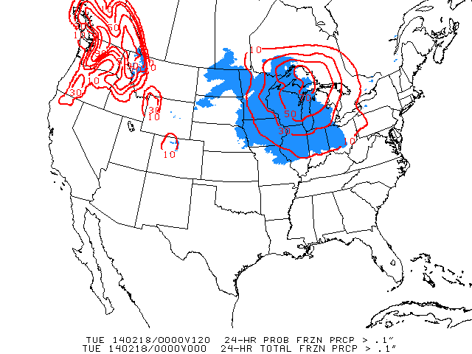
Goal: Extend Winter Weather Guidance into Days 4-7
2014 Winter Weather Experiment Results
Results were promising….but not perfect
Do have predictability, inconsistent/decreases from day 4 to day 7
Multi-ensemble approach is most effective
Guidance was under-dispersed
GEFS P-type was problematic
Conditional on precip caused problems

Slide 13
Goal: Extend Winter Weather Guidance into Days 4-7
2014 Winter Weather Experiment Results
Results were promising….but not perfect
Do have predictability, inconsistent/decreases from day 4 to day 7
Multi-ensemble approach is most effective
Guidance was under-dispersed
GEFS P-type was problematic
Conditional on precip caused problems
2014-15 Winter Season
Add CMCE for 90 member ‘super ensemble’
Replace with algorithmic p-type approach
Released to the field (NWS) starting December 1
2014-15 Winter Weather Experiment
Freezing rain, 5” snow

