Slide 1
The 2013 Flash Flood and Intense Rainfall Experiment
Faye E. Barthold^{1,2}, Thomas E. Workoff^{1,3}, Wallace A. Hogsett¹, J.J. Gourley⁴, Kelly Mahoney⁵, Ligia Bernardet⁵, and David R. Novak¹
¹NOAA/NWS/Weather Prediction Center, College Park, MD
²I.M. Systems Group, Inc., Rockville, MD
³Systems Research Group, Inc., Colorado Springs, CO
⁴NOAA/National Severe Storms Laboratory, Norman, OK
⁵CIRES/University of Colorado/ NOAA Earth System Research Laboratory, Boulder, CO

Slide 2
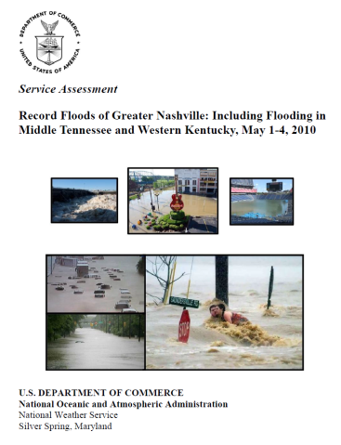
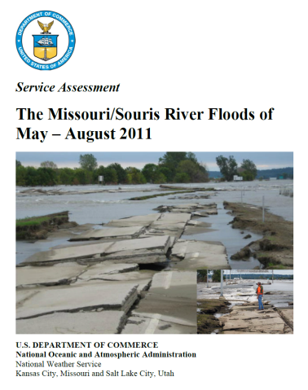
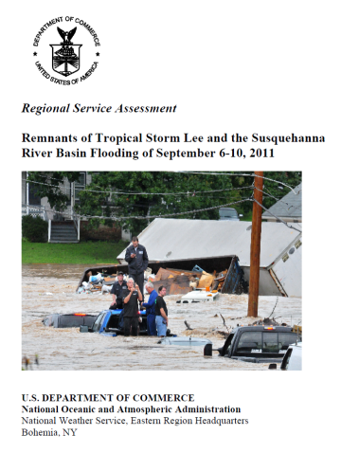
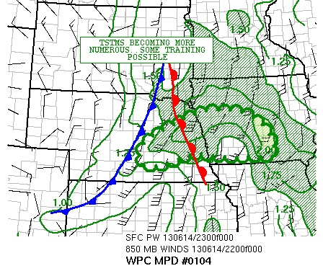
Motivation
On average, flooding results in ~$8 billion
in damages and ~90 fatalities per year
7 of the last 10 NWS Service Assessments
have involved flooding
WPC MetWatch Desk
Responsibility for heavy rainfall
mesoscale discussions transferred
from SPC to WPC on 9 April 2013
Mesoscale precipitation discussions
Event driven
Highlight regions where heavy rainfall
may lead to flash flooding in the next 1-6
hours

Slide 3
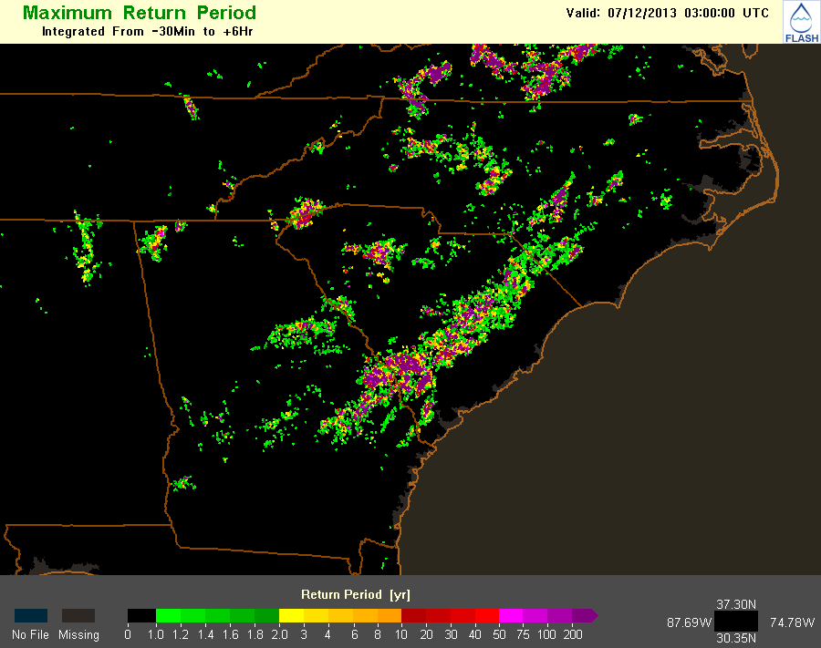
Flash Flood and Intense Rainfall Experiment July 8 – 26, 2013
Explore techniques to improve short term QPF and flash flood forecasts
High resolution convection-allowing models
Exceedance probabilities
Hydrologic information

Slide 4
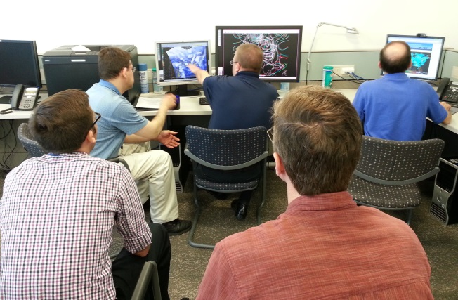
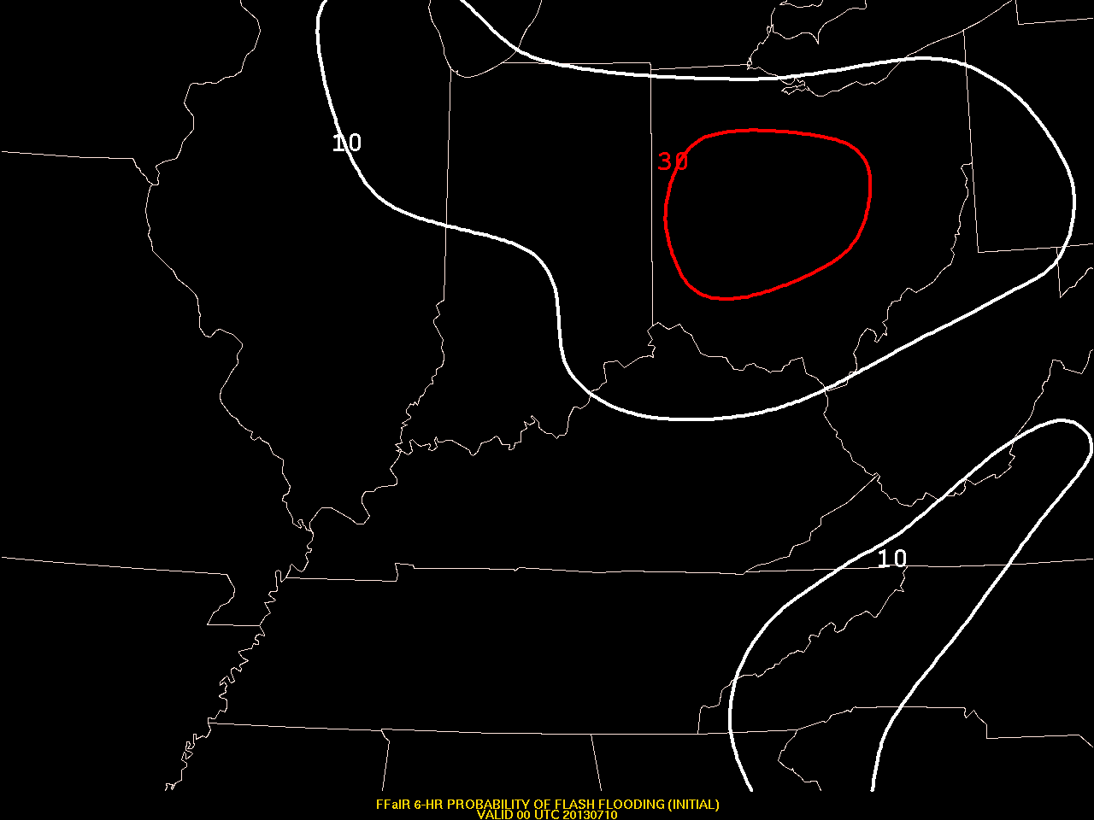
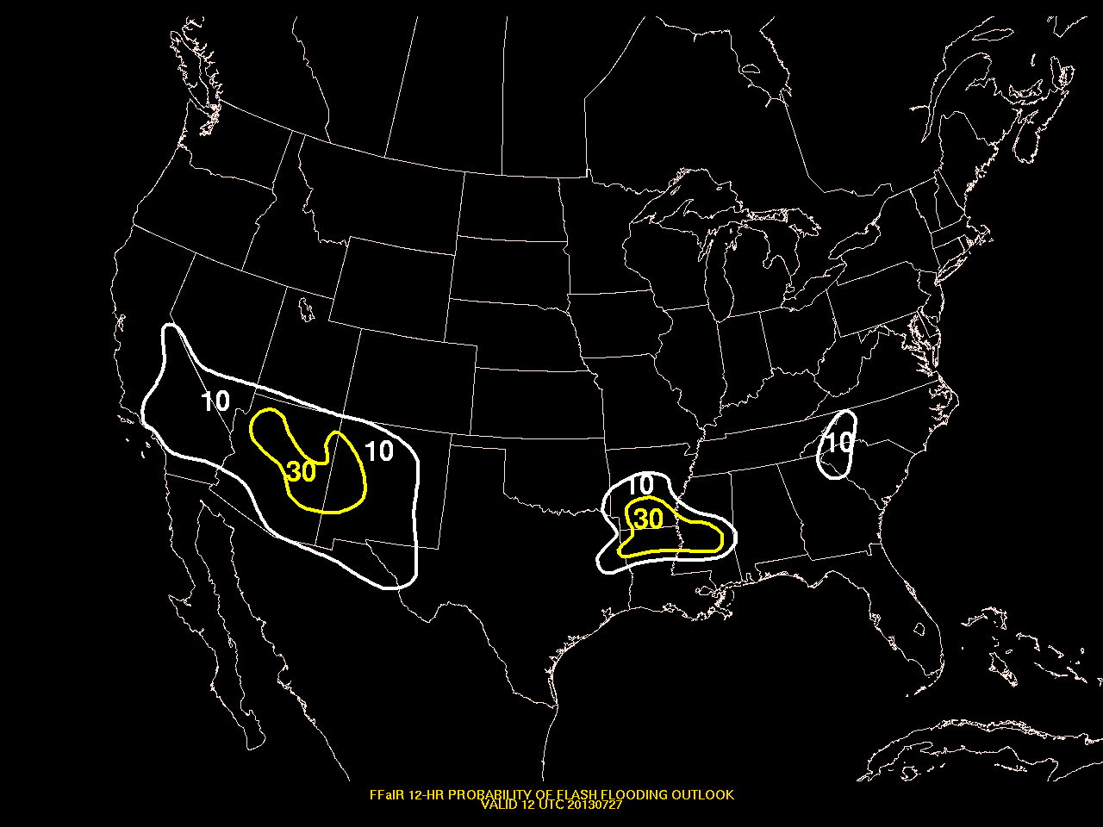
Flash Flood and Intense Rainfall Experiment July 8 – 26, 2013
26 participants representing operations, research, and academia
8 remote participants
Daily Activities
12 hr probabilistic precipitation
forecast (12 – 00 UTC)
Probability of exceeding 1”
6 hr probabilistic flash flood
forecast (18 – 00 UTC)
Prelim
Update
12 hr probabilistic flash flood
outlook forecast (00 – 12 UTC)
Subjective Evaluation

Slide 5
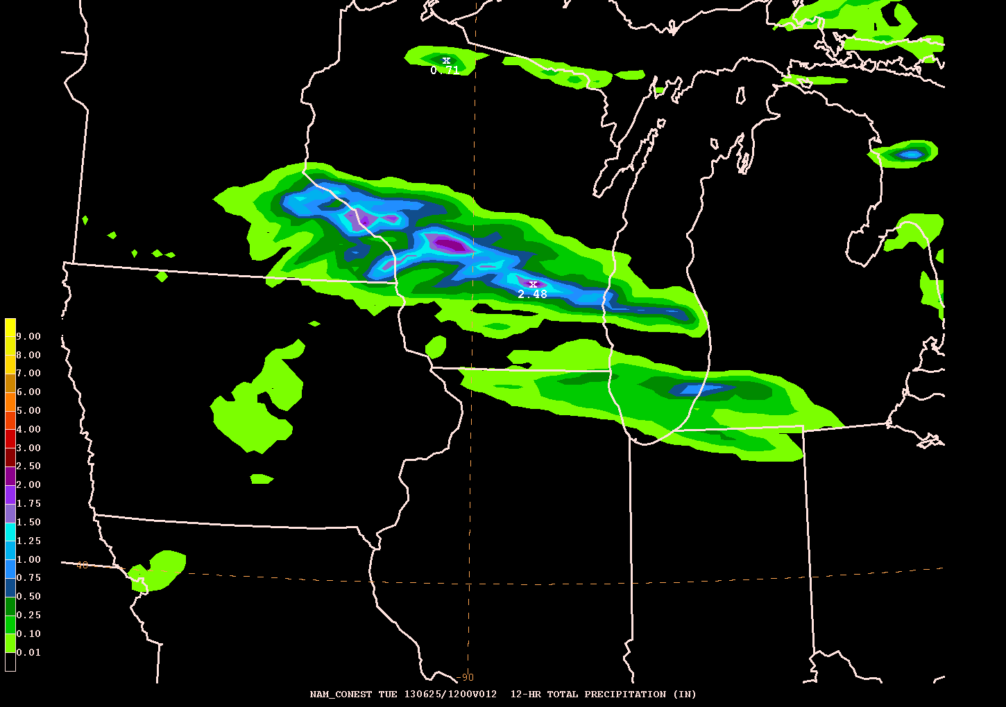
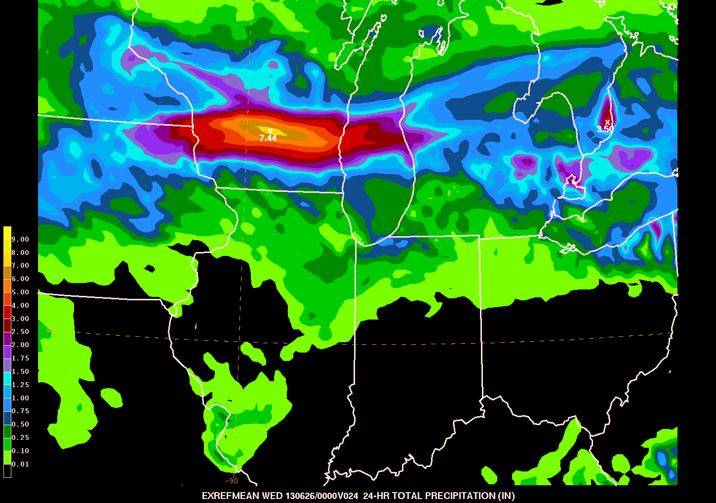
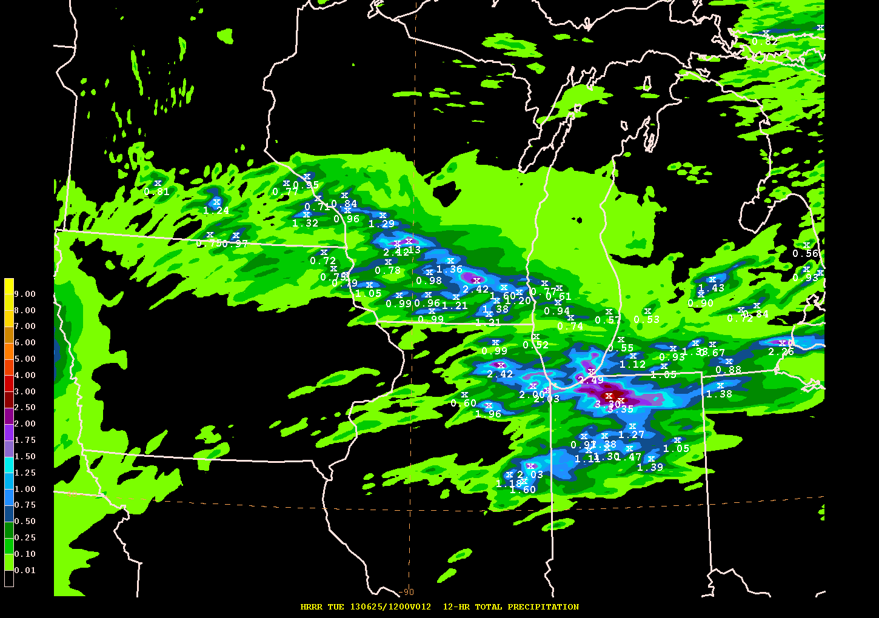
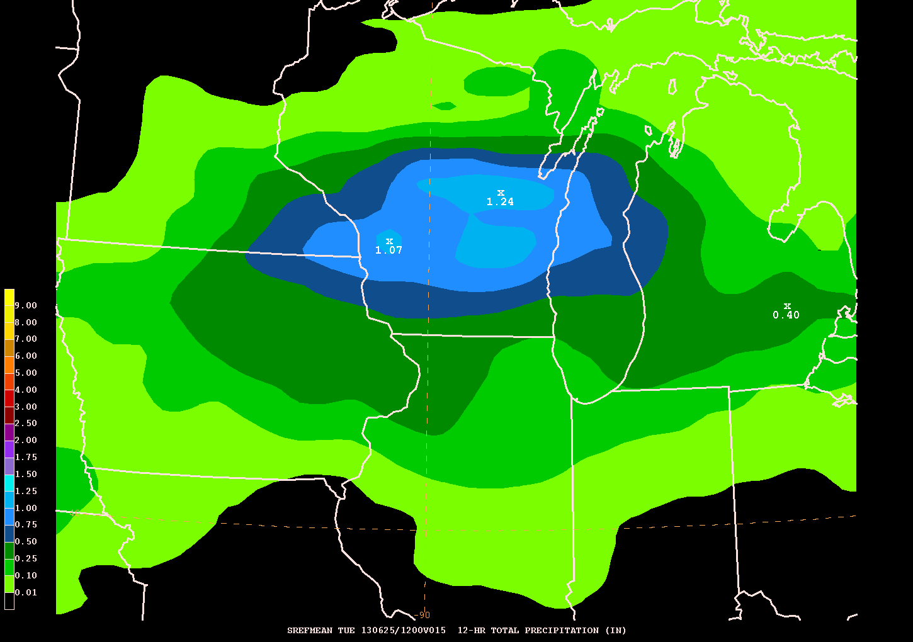
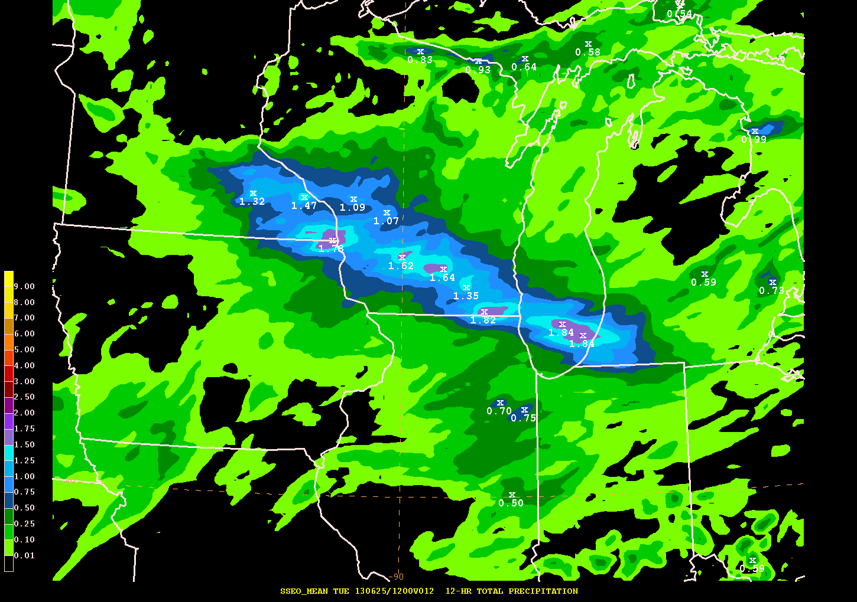
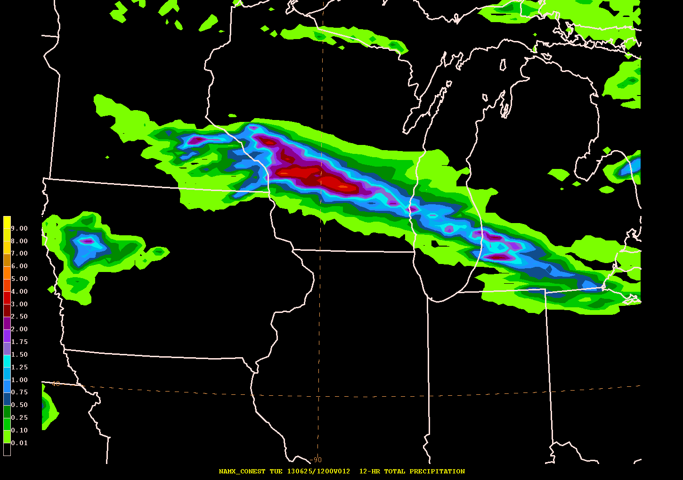
Featured Model Guidance
Provider | Model | Resolution | Forecast Hours
EMC (operational) | SREF (21 members) | 16 km | 87
EMC (operational) | NAM | 12km (parent) 4km (nest) | 84 (parent) 60 (nest)
SPC | SSEO (7 members) | 4 km | 36
ESRL/GSD | ExREF (8 members) | 9 km | 84
EMC | NAMX | 12km (parent) 4km (nest) | 84 (parent) 60 (nest)
ESRL/GSD | HRRR | 3 km | 15
NAM
ExREF
HRRR
SREF
SSEO
NAMX

Slide 6
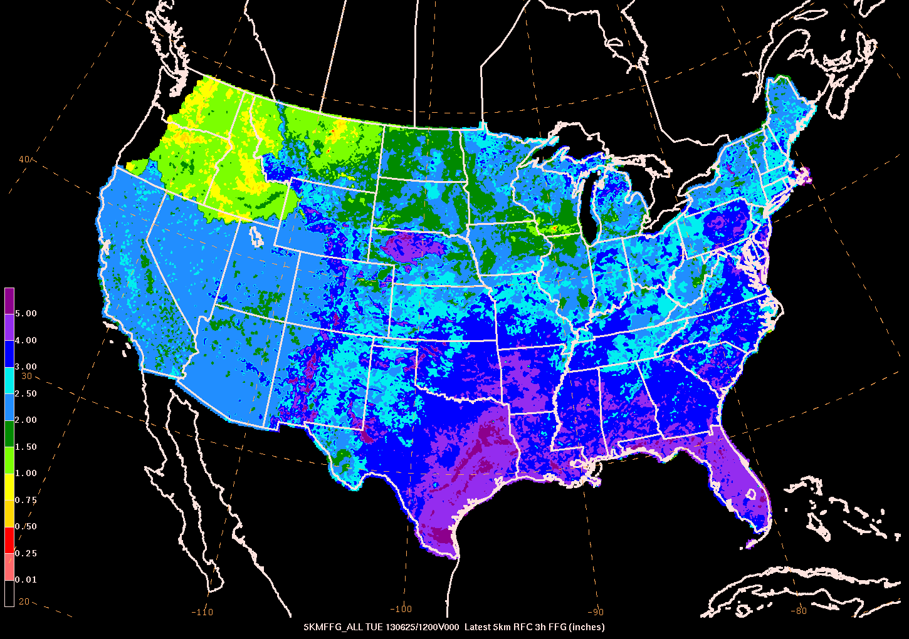
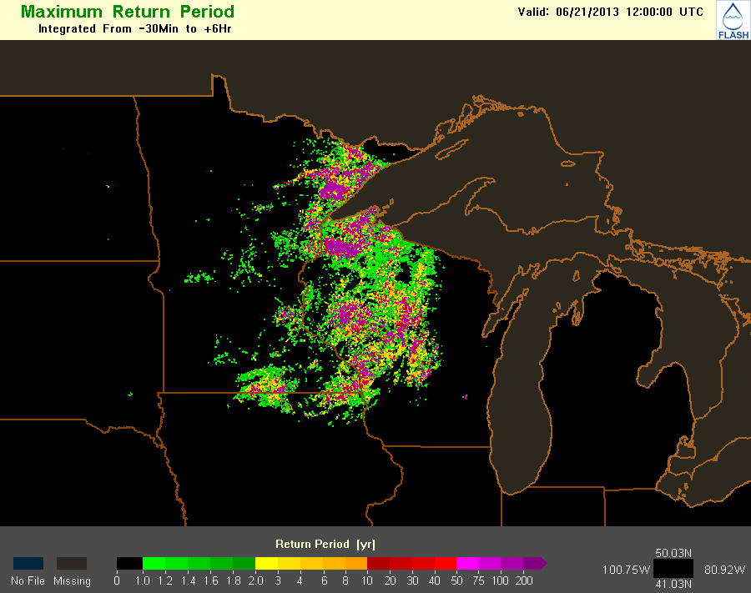
Flash Flood Diagnostics
Flash Flood Guidance (FFG)
Produced by NWS RFCs using one of four methods
Updated at the discretion of each RFC – does
not update dynamically
Flooded Locations and Simulated
Hydrographs (FLASH)
High resolution distributed hydrologic model
(250m/5min)
Forced by real time radar estimated QPE
Forecasts simulated surface water flows 6 hours
into the future
QPE recurrence intervals
QPE to FFG ratio
http://flash.ou.edu

Slide 7
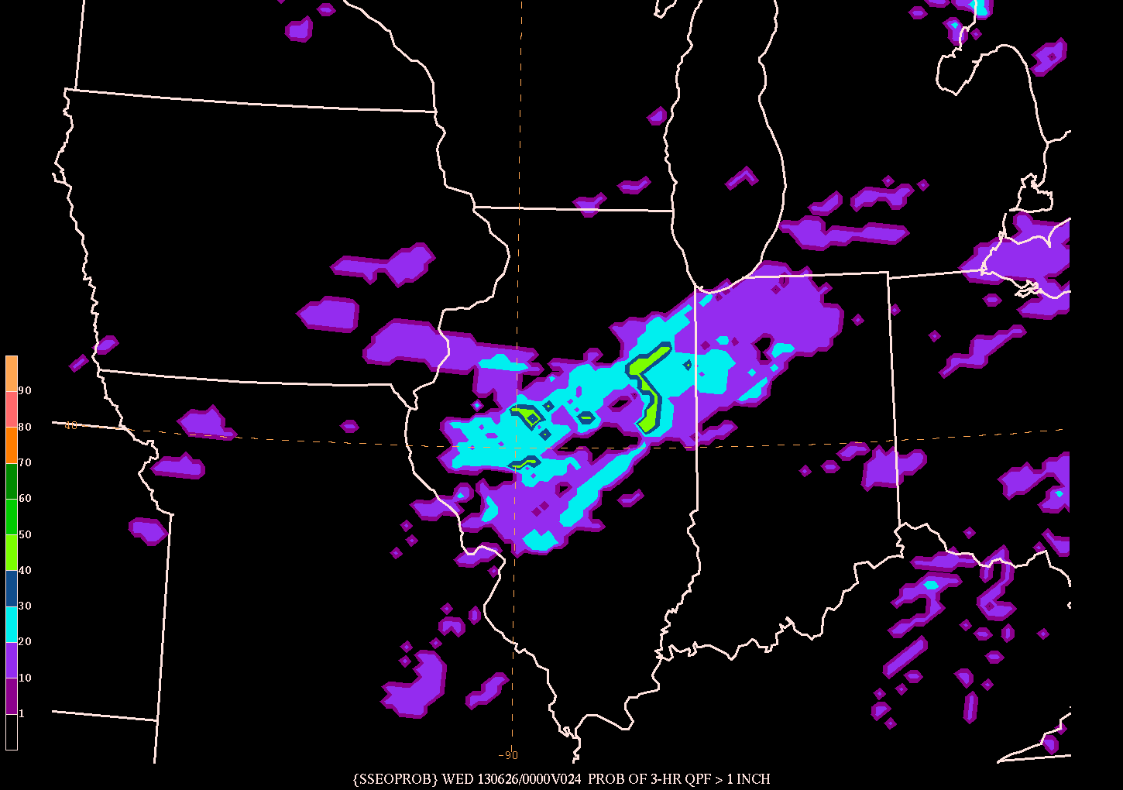
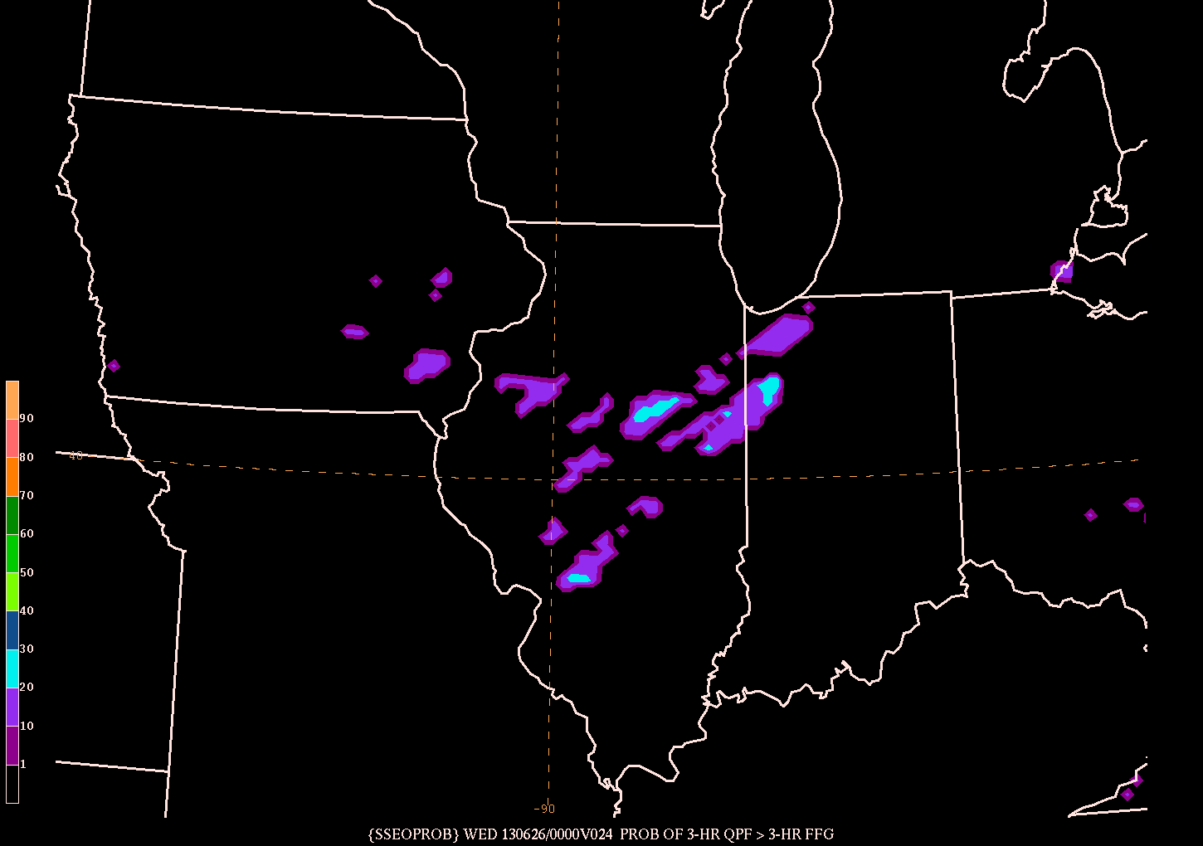
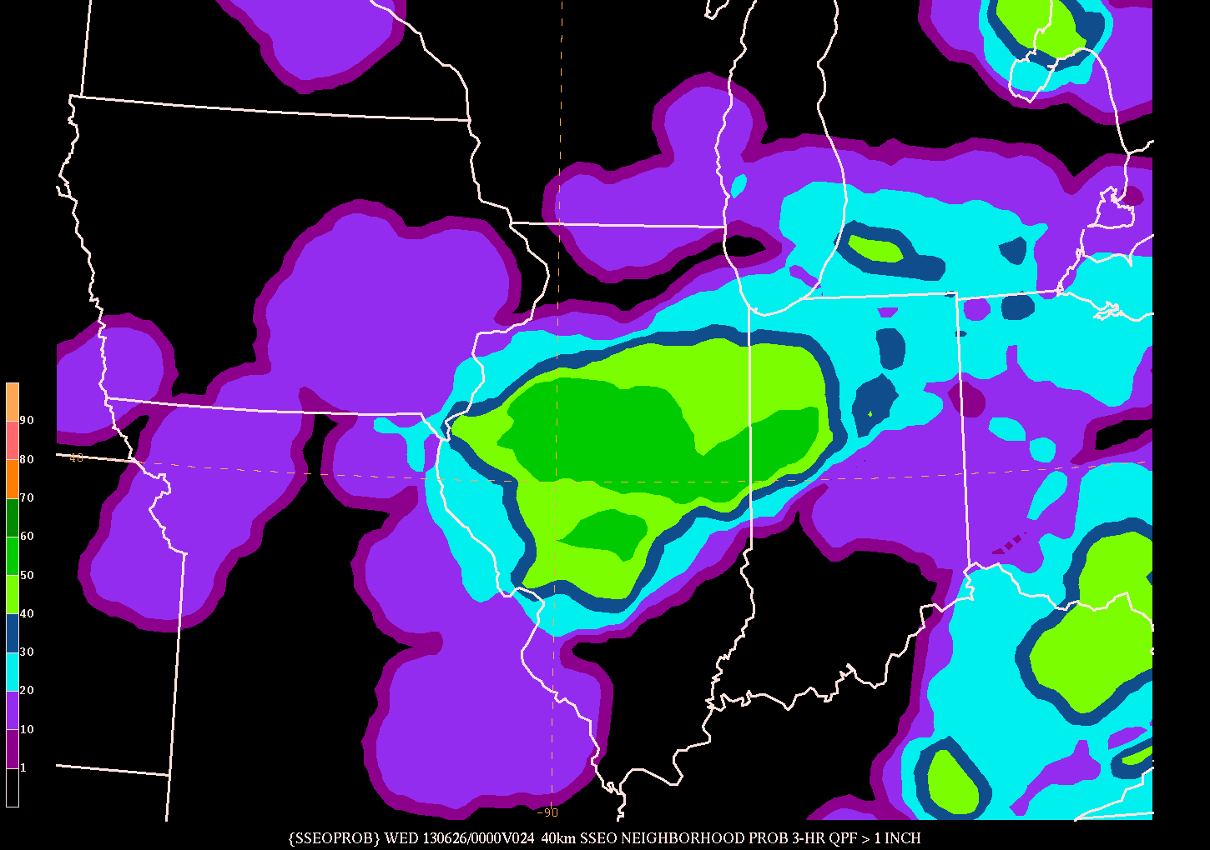
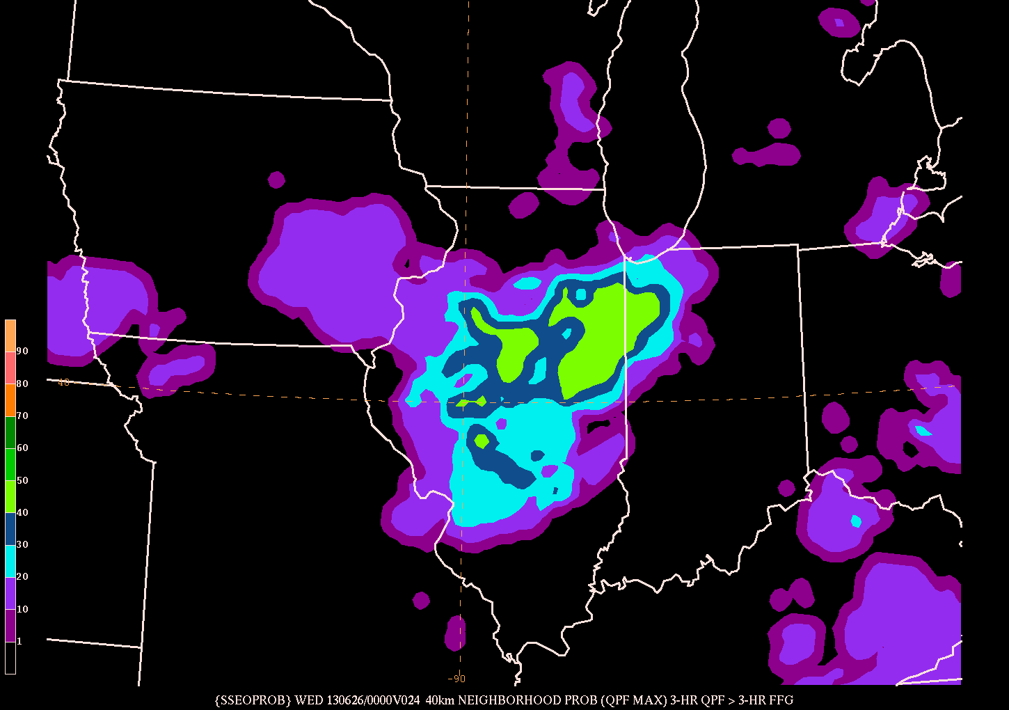
Ensemble Forecast Tools
Probability 3hr QPF > 1”
Probability 3hr QPF > 3hr FFG
Point probabilities
Probability of an event
occurring at a specific
grid point
Neighborhood probabilities
Probability of an event
occurring within a certain
distance of a grid point
20 km radius
40 km radius
Neighborhood maximum QPF
Events
Probability of QPF exceeding a threshold (e.g. >1”)
Probability of QPF exceeding flash flood guidance
40 km neighborhood
probability 3hr QPF > 1”
40 km neighborhood
probability 3hr QPF > 3hr FFG

Slide 8
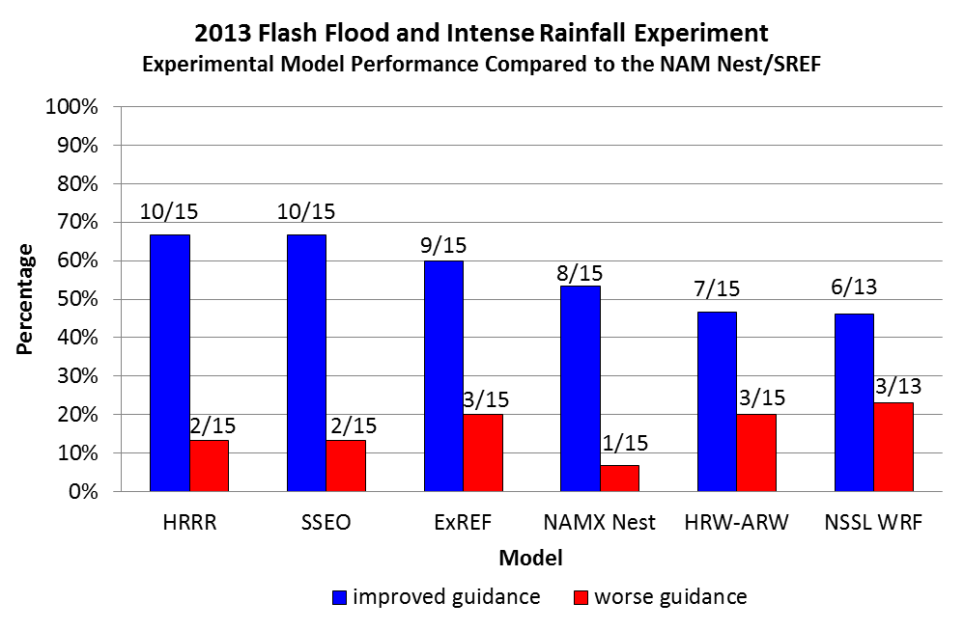
Forecast Valid 00 UTC 24 July 12 hr QPF
12 hr MRMS QPE
NAM Nest
NAMX Nest
HRRR

Slide 9
Forecast Valid 00 UTC 11 July 12 hr QPF
12 hr MRMS QPE
SREF Mean
SSEO Mean
ExREF Mean

Slide 10
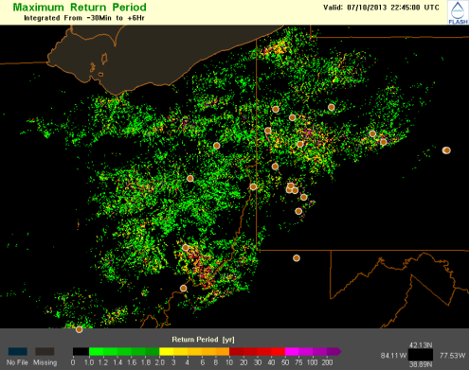
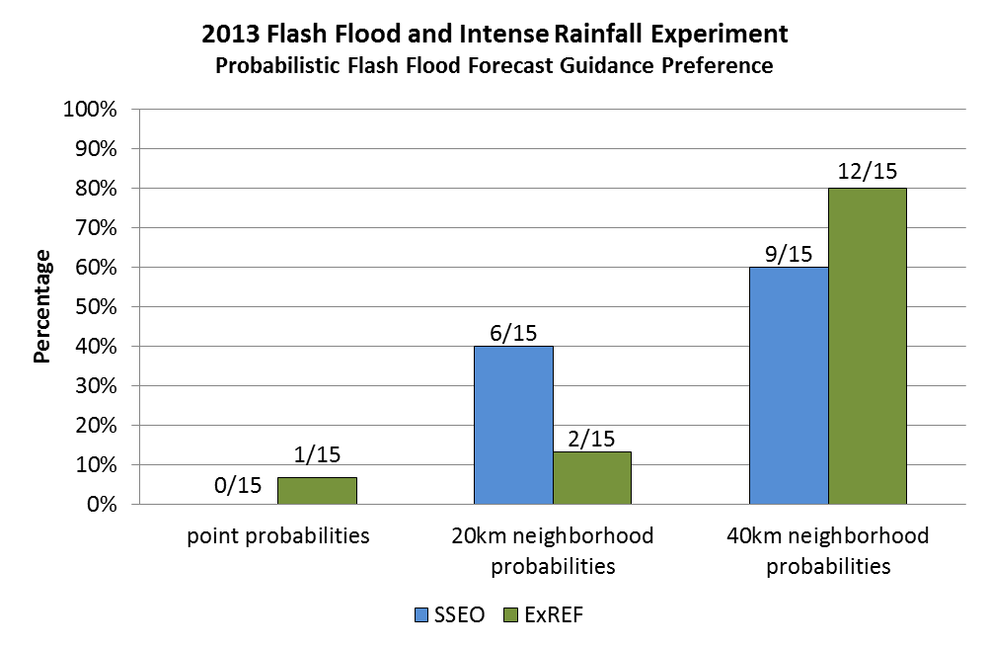
Forecast Valid 00 UTC 11 July 6 hr probability QPF > FFG
SSEO – point
SSEO – 20 km neighborhood
SSEO – 40 km neighborhood
ExREF – point
ExREF – 20 km neighborhood
ExREF – 40 km neighborhood

Slide 11
Lessons Learned
Gap in understanding between the meteorological and hydrologic aspects of flash flood forecasting
Meteorological confidence ≠ hydrologic confidence
Location, location, location – slight spatial variations change antecedent conditions, basin response characteristics, etc.
Heavy rain ≠ flash flooding
Flash flood guidance has significant limitations – does not provide a complete assessment of the flash flood threat
Different methods used at different RFCs
Data latency due to varying issuance times
Multiple time periods – 1 hr, 3 hr, 6 hr
Complex terrain presents unique challenges
Full report available at: http://www.wpc.ncep.noaa.gov/hmt/FFaIR_2013_final_report.pdf

Slide 12
Lessons Learned
High resolution convection-allowing guidance can provide valuable information about the potential for flash flooding before precipitation develops on radar
Probabilities of QPF > FFG provide valuable forecast guidance
Neighborhood probabilities can be a particularly useful forecast tool – account for spatial uncertainty in both QPF and hydrologic response
Forecasters successfully able to identify regions with a higher flash flood threat 6 – 12 hours in advance
Full report available at: http://www.wpc.ncep.noaa.gov/hmt/FFaIR_2013_final_report.pdf

Slide 13
Ongoing Work
Reduce the data latency of FFG in QPF > FFG products
Continue to explore the utility of rapidly updating hydrologic information within the flash flood forecast process
Continue to explore flash flood forecasting beyond the near-term 6 hour period
2014 experiment planned for July

