Slide 1
Recent Advancements of the Research-to-Operations (R2O) Process at HMT-WPC
Thomas E. Workoff^{1,2}, Faye E. Barthold^{1,3}, Michael J. Bodner¹, Brad Ferrier^{3,4}, Ellen Sukovich⁵, Benjamin J. Moore^{5±}, David R. Novak¹, Ligia Bernardet⁵, Tom Hamill⁶, Gary Bates⁵, and Wallace A. Hogsett¹
¹NOAA/NWS/Weather Prediction Center, College Park, MD
²Systems Research Group, Inc., Colorado Springs, CO
³I.M. Systems Group, Inc., Rockville, MD
⁴NCEP/Environmental Modeling Center, Camp Springs, Maryland
⁵CIRES/University of Colorado/NOAA Earth Systems Research Laboratory, Boulder, CO
⁶Physical Sciences Division, NOAA/Earth System Research Laboratory, Boulder, CO
±Current affiliation: Department of Earth and Atmospheric Sciences, SUNY Albany, Albany, NY

Slide 2
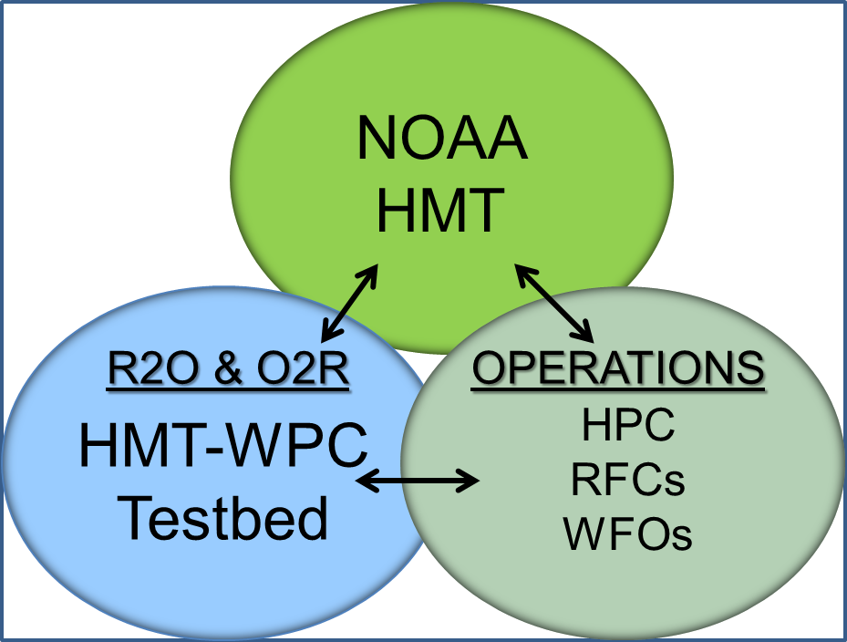
HMT-WPC: What do we do?
WPC Mission Statement: A leader in the collaborative weather forecast process delivering responsive, accurate, and reliable national forecasts and analyses.
Accelerate the transfer of scientific and technological innovations into operations to enhance WPC products and services.

Slide 3
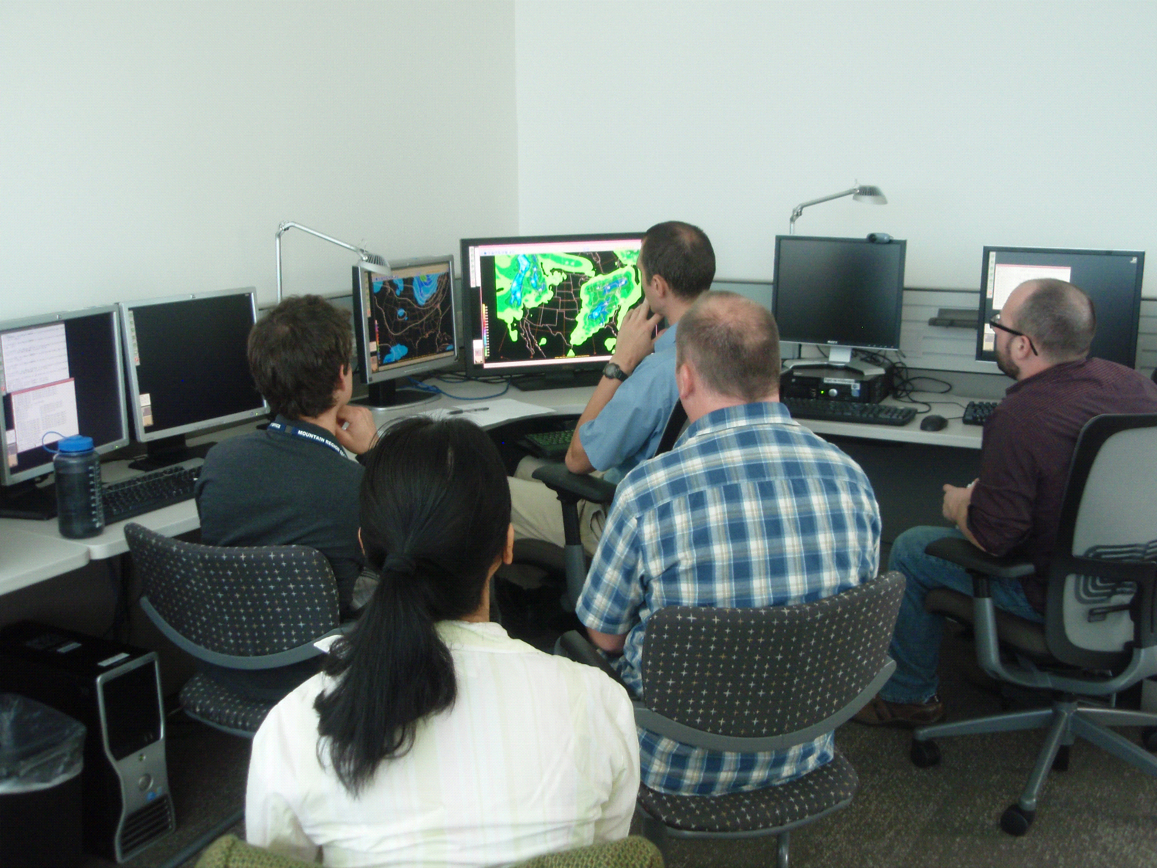
R2O at WPC: How it Really Works
Three-step transition process:
Identify/develop and test new datasets, models and techniques
NAM Rime Factor Snowfall, ExREF, 2nd Generation Reforecast Data
Test in forecast experiments
Winter Weather Experiment
Atmospheric River Retrospective Forecasting Experiment (ARRFEX)
Flash Flood and Intense Rainfall Experiment

Slide 4
R2O at WPC: How it Really Works
Three-step transition process:
Identify/develop and test new datasets, models and techniques
NAM Rime Factor Snowfall, ExREF, 2nd Generation Reforecast Data
Test in forecast experiments
Winter Weather Experiment
Atmospheric River Retrospective Forecasting Experiment (ARRFEX)
Flash Flood and Intense Rainfall Experiment
Subjective and objective evaluation: does it provide value in the forecast process?
Does it help the forecaster make a better forecast?

Slide 5
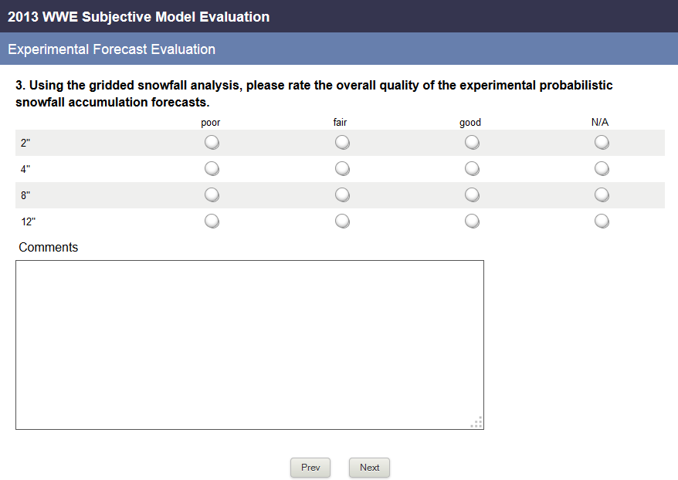
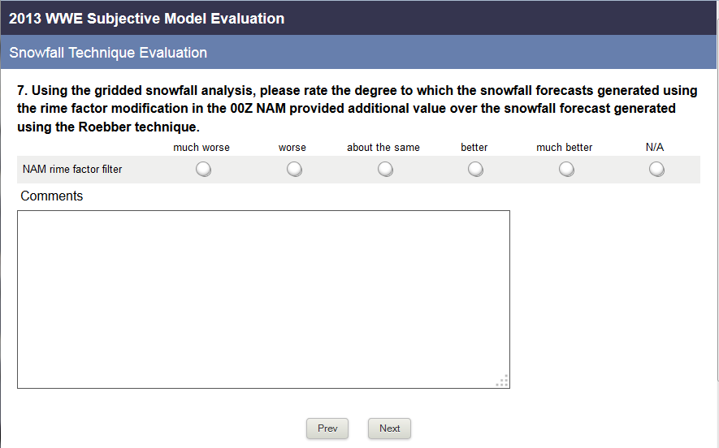
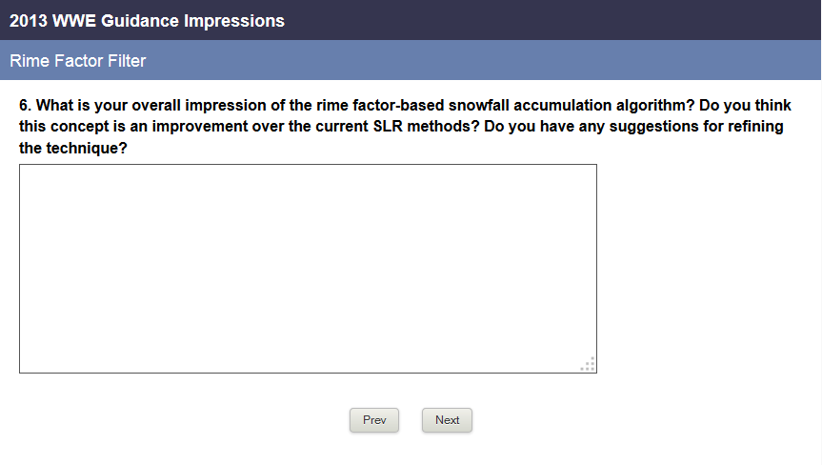
A Penny for Your Thoughts?
How accurate was your forecast?
Did the experimental guidance provide any benefit?
Impressions? Feedback? How can we improve it?

Slide 6
R2O at WPC: How it Really Works
Three-step transition process:
Identify/develop and test new datasets, models and techniques
NAM Rime Factor Snowfall, ExREF, 2nd Generation Reforecast Data
Test in forecast experiments
Winter Weather Experiment
Atmospheric River Retrospective Forecasting Experiment (ARRFEX)
Flash Flood and Intense Rainfall Experiment
Subjective and objective evaluation: does it provide value in the forecast process?
Does it help the forecaster make a better forecast?
Operational training and implementation
Establish dependable data format, data feed, train forecasters on most effective uses, etc.

Slide 7
Goal: Improve Snowfall Forecasts: NAM Rime Factor-Modified Snowfall
Model snowfall forecasts are often, um, uninspiring….
Instantaneous process: QPF x ptype x SLR = snowfall
Modifies Roebber* SLR (courtesy of Brad Ferrier, EMC)
Rime Factor (instantaneous) – indicates amount of growth of ice particles by riming and liquid water accretion
Percent Frozen QPF (instantaneous) – percent of precipitation reaching the ground that is frozen
1 < RF < ~2 no change to Roebber SLR
~2 < RF < ~5 Roebber SLR reduced by factor of 2
~5 < RF < ~20 Roebber SLR reduced by factor of 4
RF > ~20 Roebber SLR reduced by factor of 6
*Roebber, P. J., S. L. Bruening, D. M. Schultz, and J. V. Cortinas, 2003: Improving snowfall forecasting by
diagnosing snow density. Wea. Forecasting, 18, 264-28

Slide 8
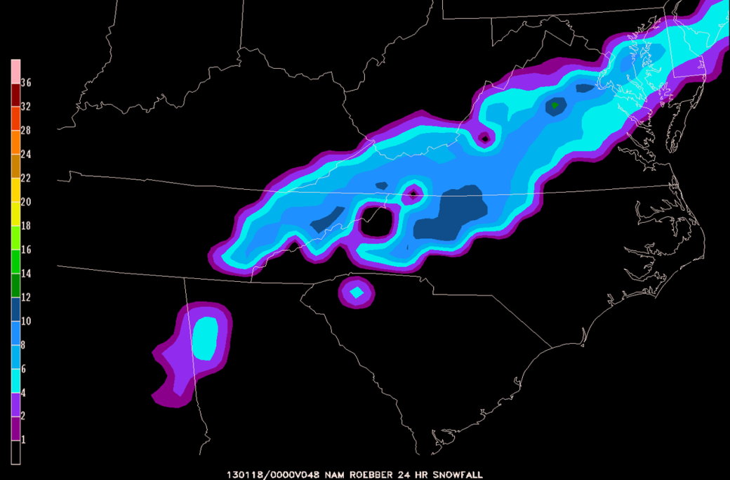
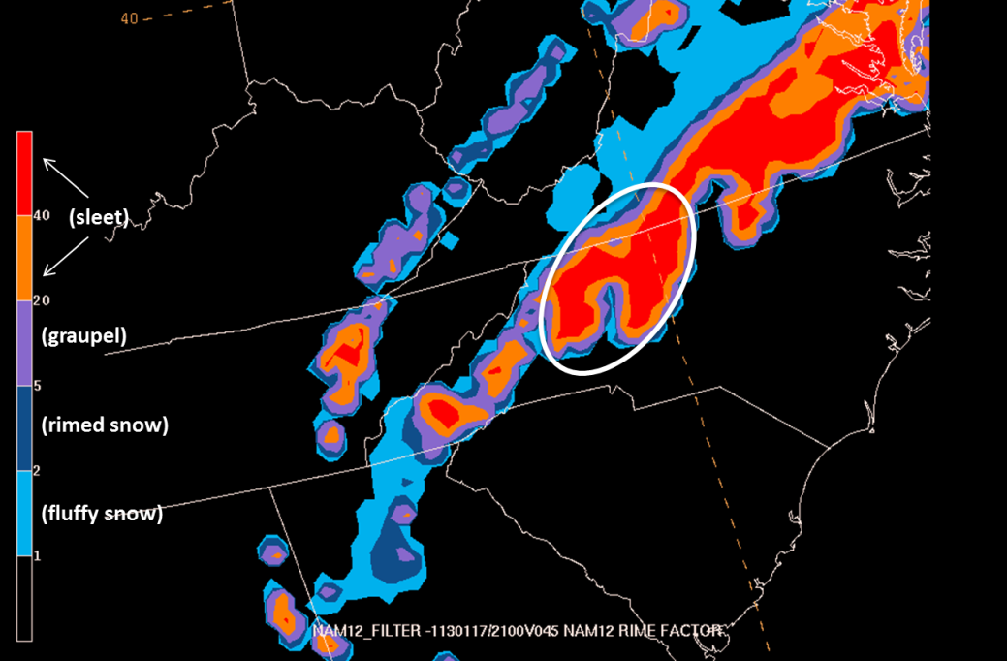
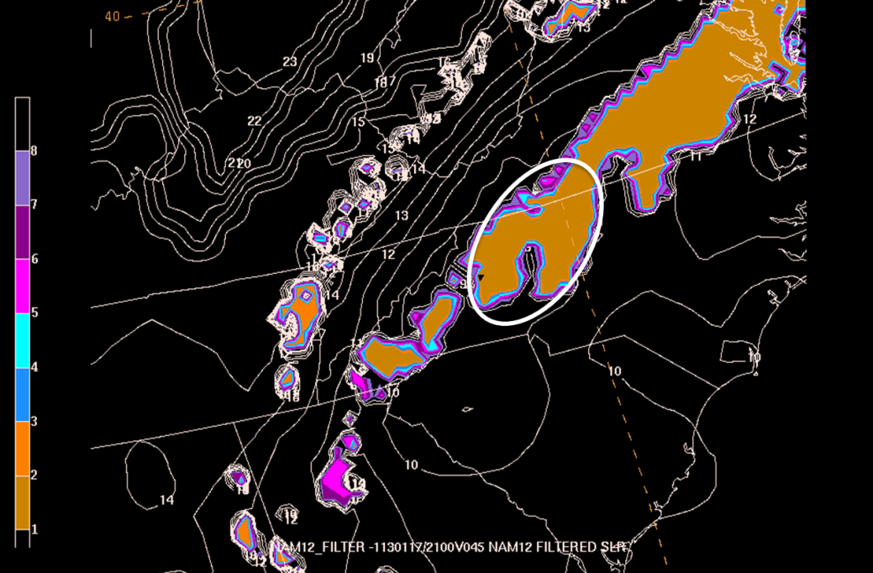
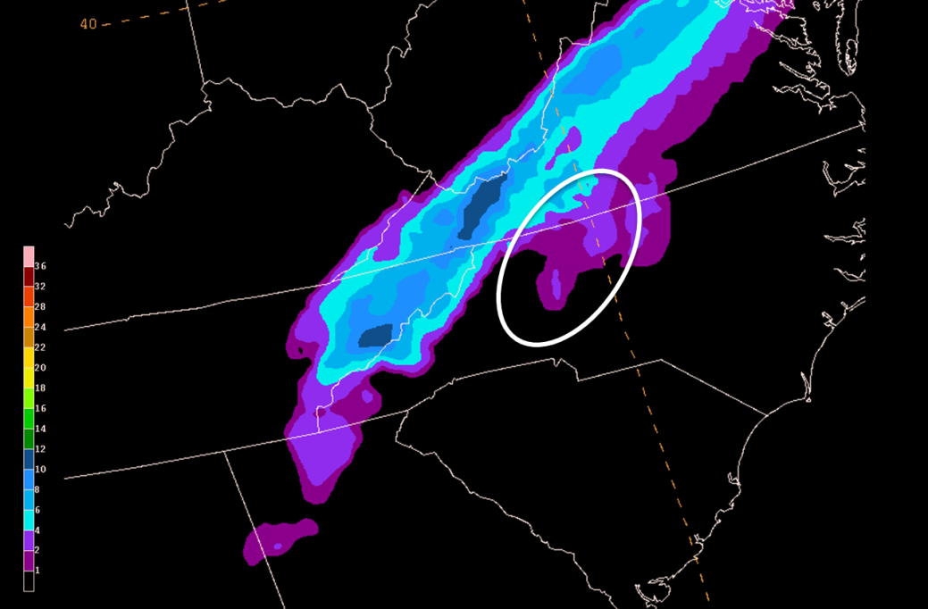
Example: January 17-18, 2013
NAM Roebber Snowfall
NAM Rime Factor
NAM Rime Factor SLR
NAM RF-modified Snowfall

Slide 9
What we learned in 2013 WWE:
Overall favorable reception
Rime factor, percent frozen precip, SLR modification
Helps identify areas where precipitation-type could be a concern
Main drawbacks:
Only applied to the NAM (and its QPF)
Resolution differences made comparison to standard NAM Roebber snowfall difficult
Going forward:
Apply it to SREF or GFS?
Combine snowfall forecast with land use parameterization → potentially improve accumulation forecasts(?)

Slide 10
Goal: Improve Predictive Skill of Extreme Precipitation Events
ESRL/PSD 2nd Generation Reforecast Dataset
2nd generation GEFS (version 9.0.1); 1985-2010
10 members plus control run; archive 00Z initializations
Ranked analog PQPF and deterministic QPF
Hamill and Whitaker (2006): reforecast dataset an improvement on operational guidance (PQPF)
Evaluated in 2012 Atmospheric River Forecasting Experiment (ARRFEX)
ESRL/GSD Experimental Regional Ensemble Forecasting system (ExREF)
Multi-physics, multi-initial condition, multiple boundary condition convection allowing ensemble
9 km resolution
Evaluated in ARRFEX and 2013 Flash Flood and Intense Rainfall Experiment

Slide 11
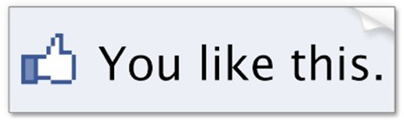
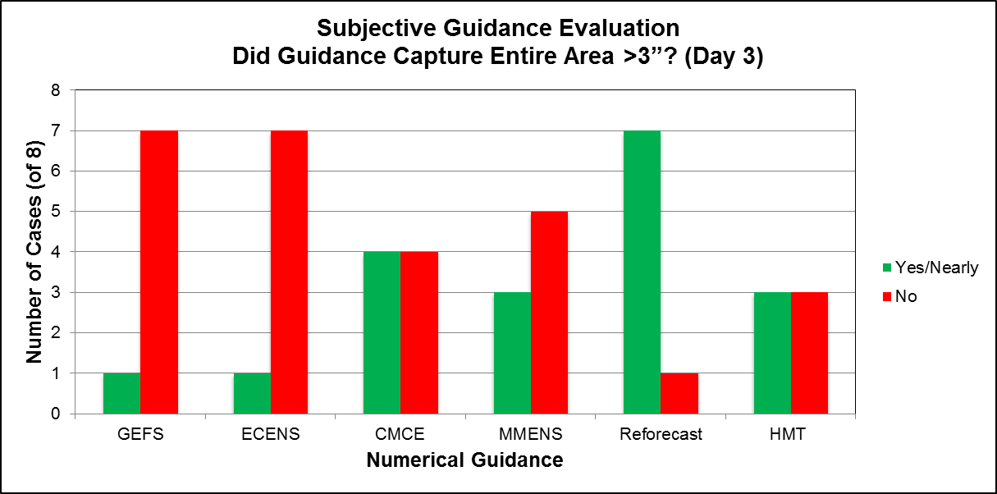
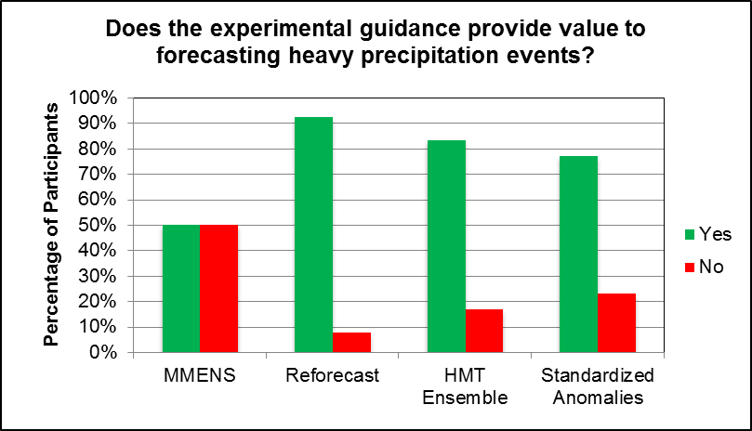
Example: How did they perform?
Forecasters reacted favorably to the reforecast dataset in ARRFEX, particularly in its ability to identify areas at risk for heavy precipitation at mid-range lead times
Forecasters also found the ExREF helpful in ARRFEX and noted it showed promise in FFaIR
→ Potential of hi-res ensembles, difficult to produce desired dispersion at short lead times
→ Reforecast deemed ‘most helpful’ in 6 cases

Slide 12
Implementation: WPC/ESRL R20 Process for the ExREF

Slide 13
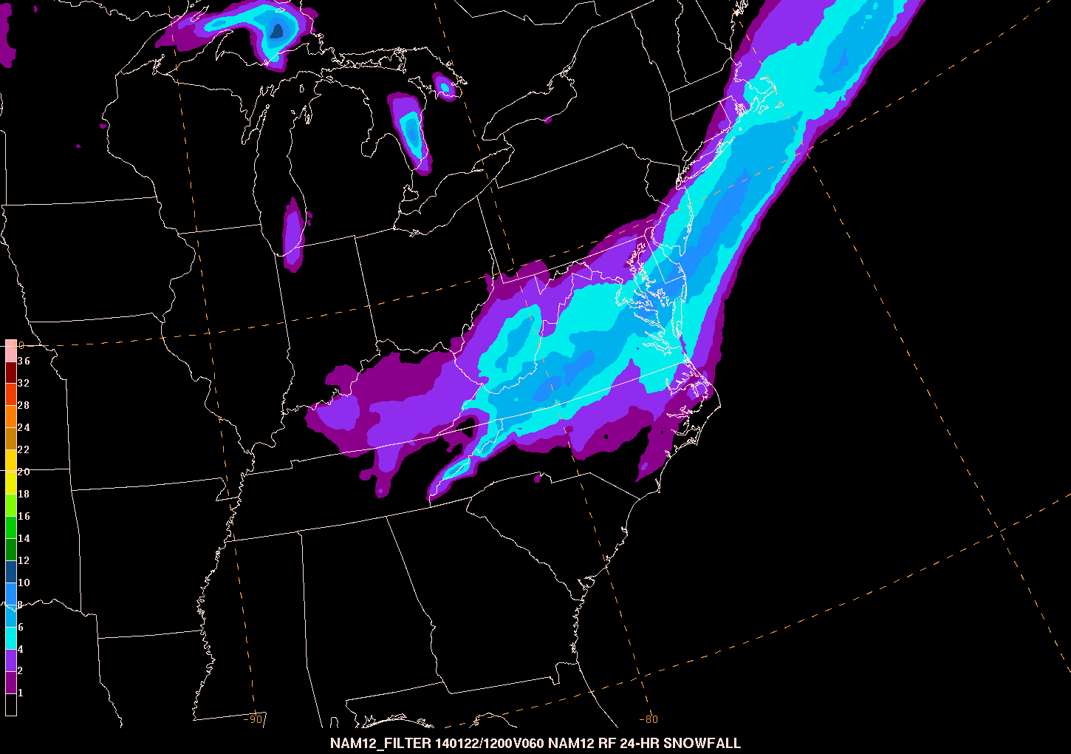
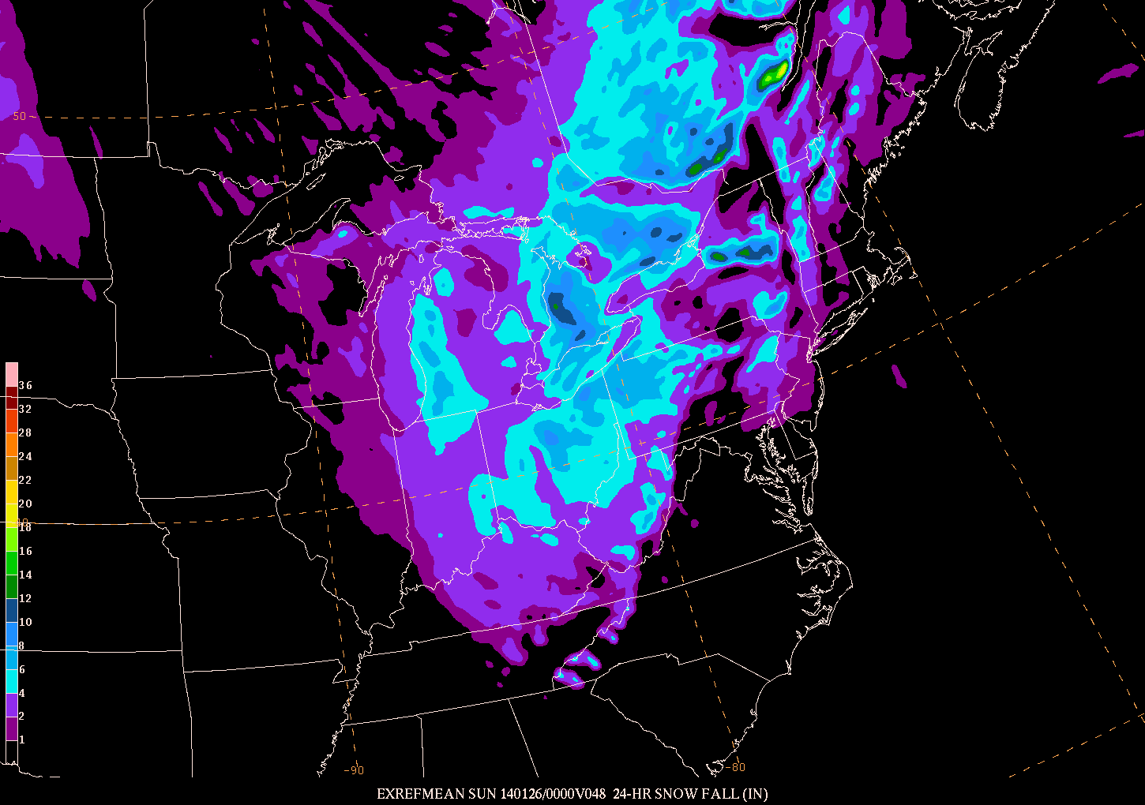
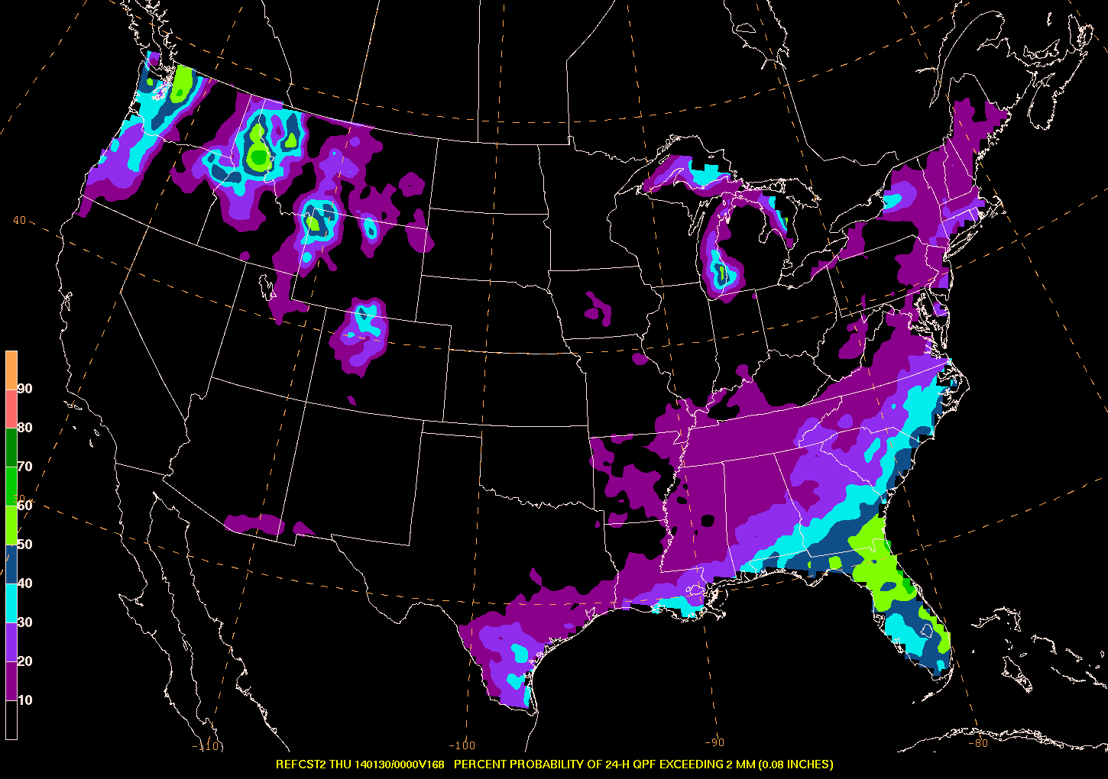
Where We Stand Today….
Rime Factor (NAM) available to forecasters
Undergoing additional testing in 2014 WWE
Expanded to SREF snowfall
ExREF available in operations to forecasters
Winter weather parameters being evaluated in 2014 WWE
Plans to include it in 2014 FFaIR
Reforecast data available to forecasters
Deterministic QPF, PQPF
Evaluated in WWE, prototype Day 4-7
NAM RF Snowfall
ExREF Snowfall
Reforecast PQPF

Slide 14
What You Should Take Away…
TEST → EVALUATE → TRAIN AND IMPLEMENT
WPC-HMT continually works with colleagues to investigate ways to improve WPC operations
A Few Examples:
Ensemble Sensitivity Tool (SUNY Stonybrook) Storm Scale Ensemble of Opportunity (SPC)
SREF parallel (EMC) Ensemble Clustering (EMC)
AFWA High-Resolution Ensemble (AFWA) HMT-Ensemble (ESRL/HMT)
GEFS 2nd Generation Reforecast Dataset (ESRL) NAM Rime-Factor Modified Snowfall (EMC)
For the WPC, testing in the operational setting is imperative
Experiments → it’s not just about objective scores
Implementation can be a big hurdle
Beneficial → Efficient → IT Compatible → Dependable

